Slide 1
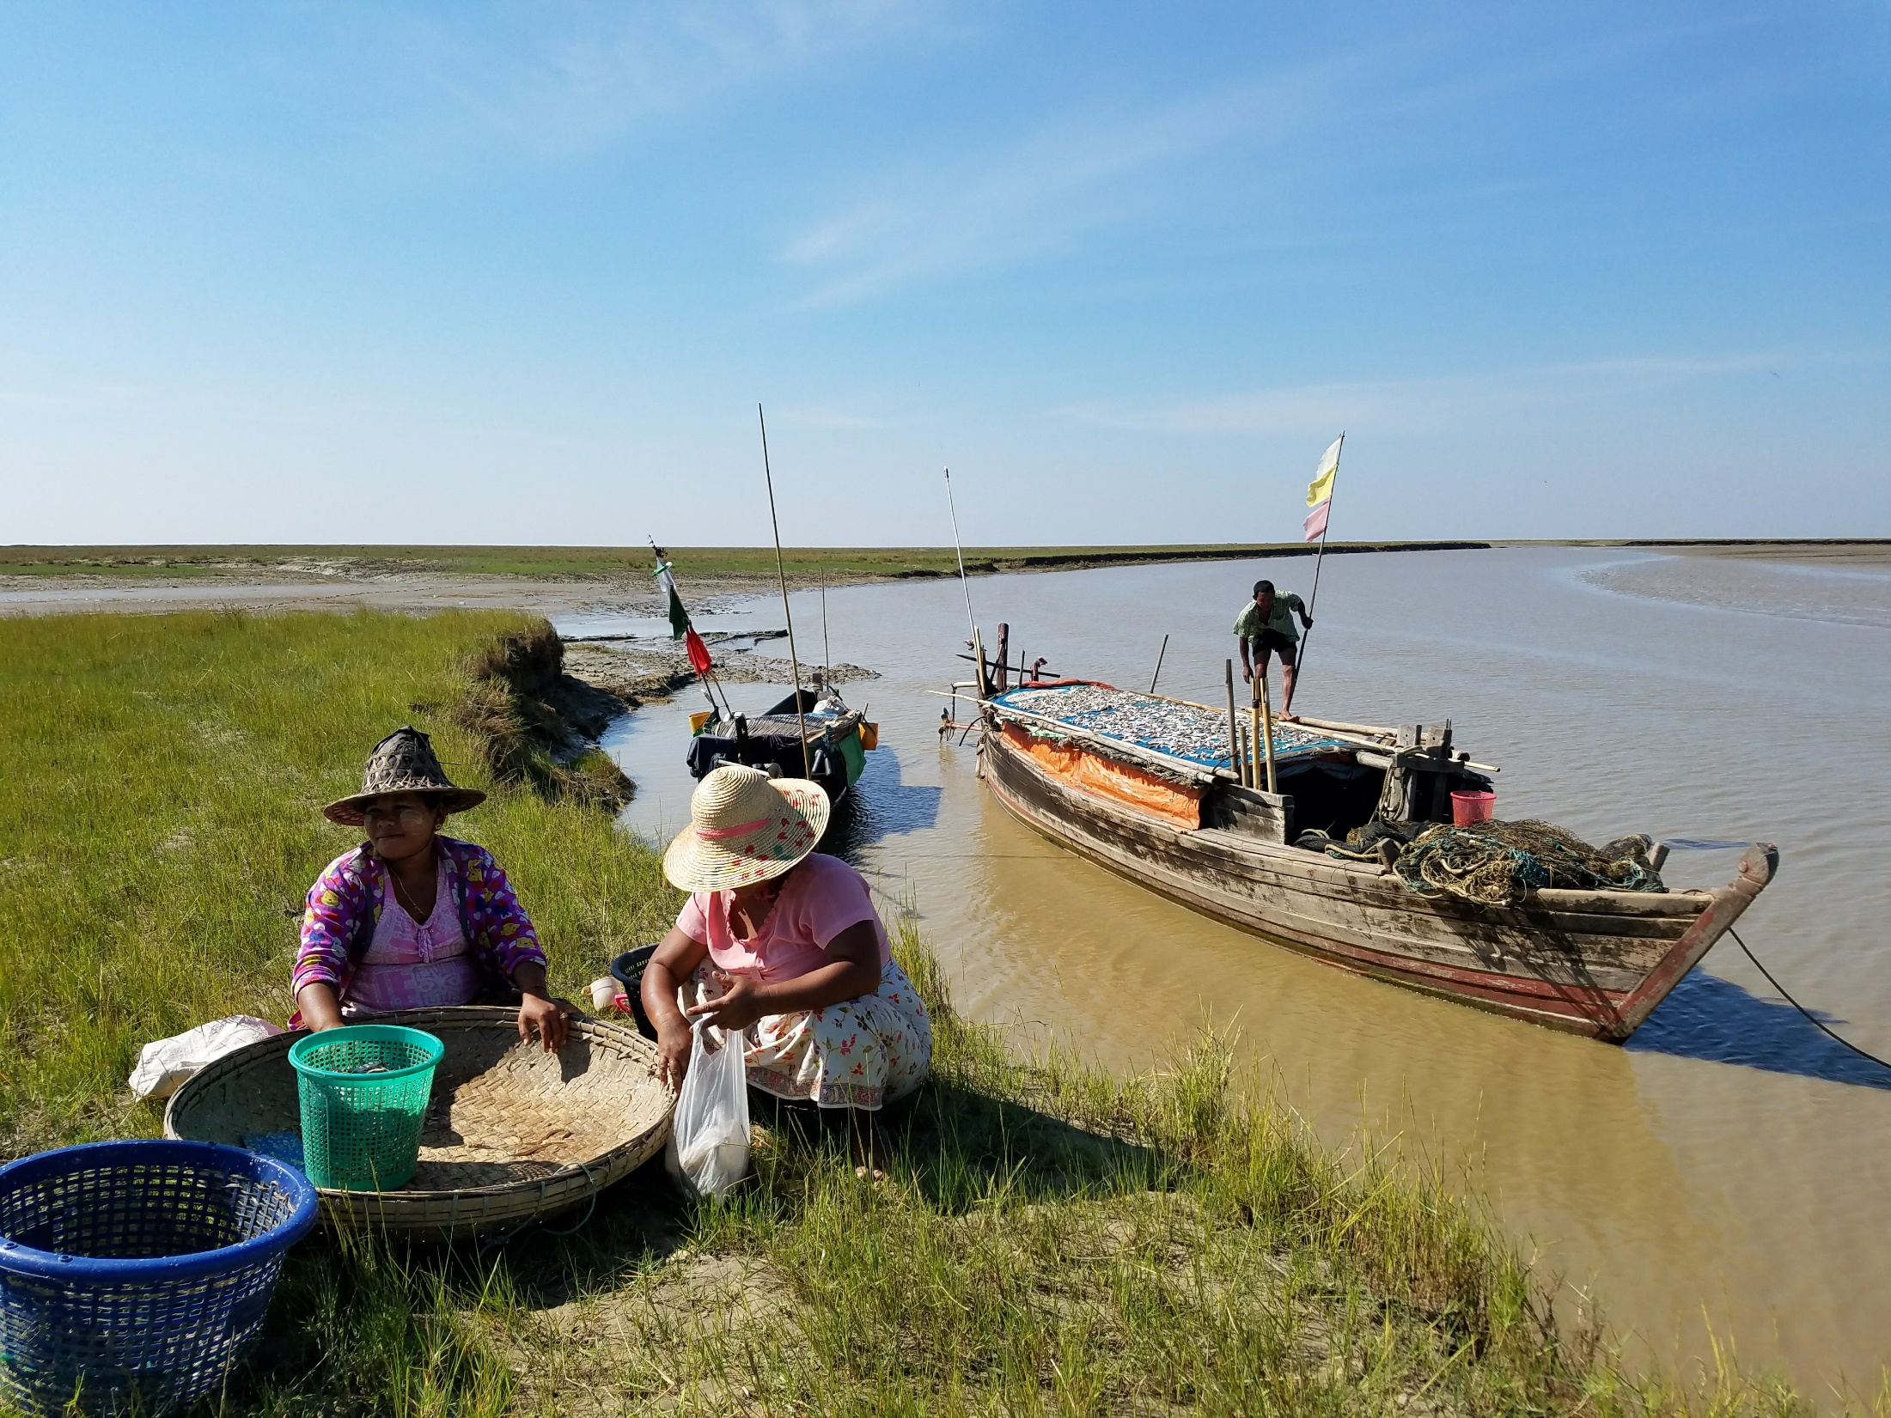
gender & natural resource management
training for SRJS Myanmar
by IUCN & Point B Design + Training
February 19-23, 2018 | Myeik
Dr. Tara Sayuri Whitty | IUCN
Wint Hte, Aung Naing Soe, Yin Yin | Point B

Slide 2
gender & natural resource management
What do you think when you hear “gender training”?
HOW STRONGLY DO YOU AGREE?
(1 = strongly disagree, 5 = strongly agree; ? = don’t know)
I care about gender in natural resource management
Women can play an important role in natural resource management
Gender issues are only a concern for women
Men should play an active role in gender inclusion
Women have enough rights & inclusion in natural resource management
training for SRJS Myanmar
by IUCN & Point B Design + Training
February 19-23, 2018 | Myeik
Notes:
To start, we are curious what your ideas about gender training are. When you hear “gender training”, what do you think? What do you expect?
Now, we would like to learn more about your ideas on gender in natural resource management. Here are 5 statements. On a piece of paper, write the statement # and write your response to these statements. If you strongly agree, your response is 5. If you agree, 4. If you feel neutral, 3. If you disagree, 2. If you strongly disagree, 1. If you don’t know, “?” Then hand your paper to us. Your answers are completely private!
[Read out statements; participants write and hand in responses; review responses during next available break]
We will review these responses later. For now, I will say that I hope this training will help make more clear why:
Gender is important in NRM
Women can play a very important role
Gender issues are NOT only a concern for women
Men should play an active role
Women need more rights and inclusion in NRM

Slide 3
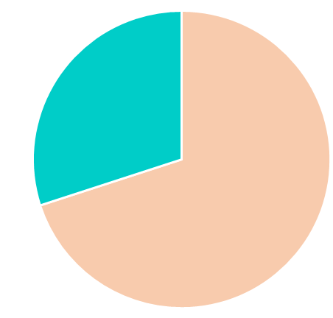
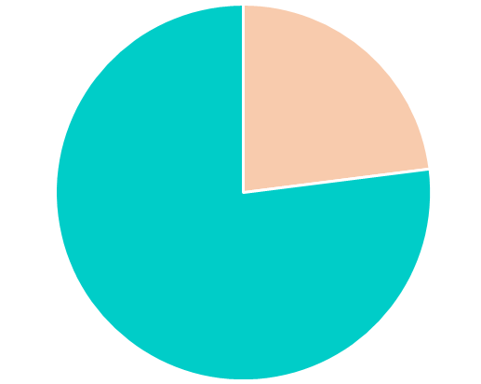


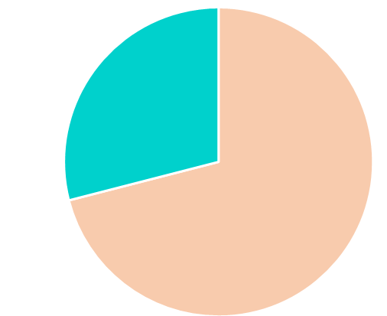
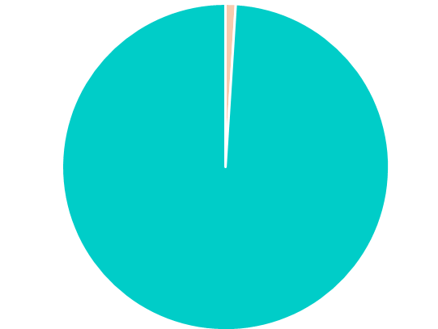
gender &
natural resource management
Inequality beween women and men globally
people living on
<1 USD/Day¹
seats in parliaments (2016)²
human trafficking victims³
% of land owned¹
Notes:
To start, let’s look at some general information on the different experiences of the different genders from global information.
In the world:
70% of the people living on <1 USD/day are women
1% of land is owned by women
22% of parliament seats are filled by women
71% of human trafficking victims are female (girls and women)
¹IUCN Training manual on gender
²Inter-Parliamentary Union. “Women in national parliaments, as of 1 June 2017
³Global Report on Trafficking in Persons 2016
General references:
http://www.unwomen.org/

Slide 4
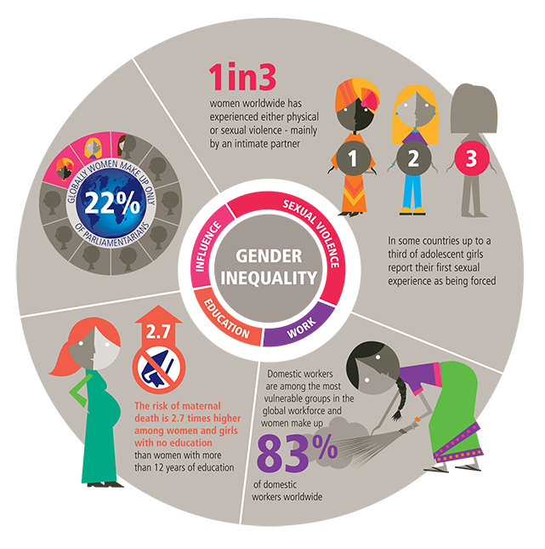
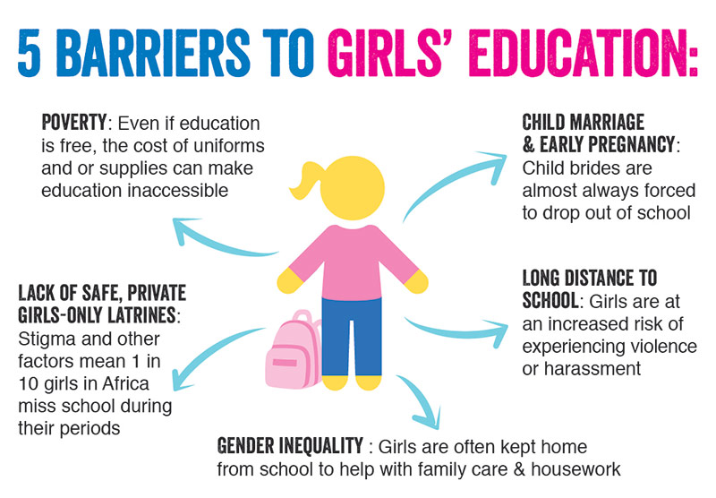
gender &
natural resource management
Notes:
There are many good resources about gender issues worldwide. Here are some examples –
This figure shows barriers to girls’ education. For example, girls who need to travel long distances to school without adult supervision are at higher risk of harassment and violence. Also, girls are often kept home from school to help their families.
This other figure shows various areas of gender inequality, including violence – 1 in 3 women worldwide has experienced physical or sexual violence.
Figure: Plan Canada - Gaps in education
Figure: IPPF Gender Report – GBV, work inequality, maternal death

Slide 5
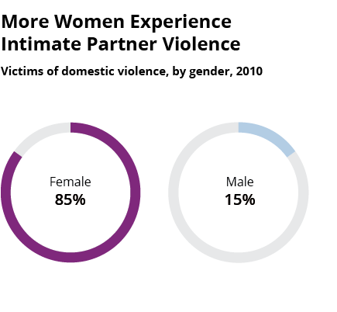
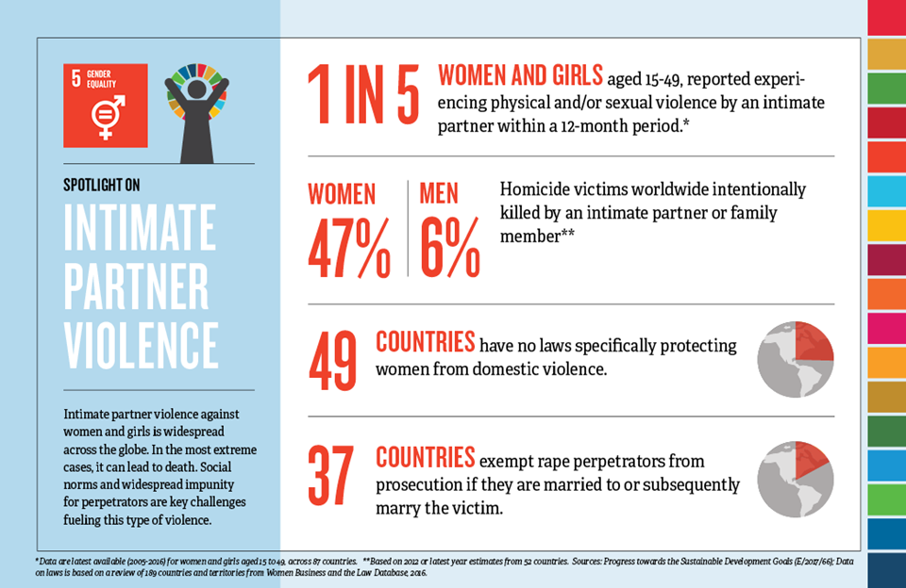
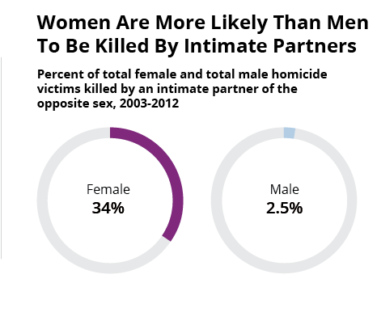
gender &
natural resource management
Notes:
Violence against women, or gender-based violence, is a particular concern in gender issues.
In this figure from the US, women are more likely to be victims of violence by intimate partners.
In the second figure, more statistics show that women are at higher risk than men of being killed by an intimate partner or family member, and that many countries do not have a strong policy framework for protecting women.
We mention these examples of gender equality to demonstrate that women and men have very different life experiences in several very serious ways. The challenges and risks that women face affect their experiences in every sector, including natural resource management (NRM). When we think about gender in NRM, we need to also remember that gender inequality goes across many different issues.
Figure: domestic violence - https://www.huffingtonpost.com/2014/10/09/men-killing-women-domesti_n_5927140.html
Figure: GBV – Sustainable Development Knowledge Platform

Slide 6
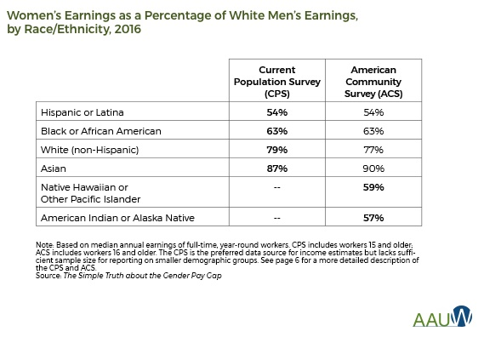
gender & intersectionality
...
ethnicity
age
gender
class
religion
ability
Notes:
It is important to know that gender is not the only characteristic that affects a person’s experiences and opportunities. Considering multiple characteristics, and their impact on a person’s experiences, is called “intersectionality.” In other words, not all men have the same experiences, and not all women have the same experiences.
Your experiences and opportunities are shaped by your gender, but also by: ethnicity, class, ability, religion, age, and many other factors – for example, sexual orientation.
As an example, this table shows how the earnings of women compare to those of white men in the USA. This includes information on different ethnicities of women. Women from South America earned 54% of what white men earned. Black women earned 63%. White women earned 79%. And Asian women earned 87%. So, even though all of these groups of women earn less than men, that difference is greater for Latina and Black women than it is for white or Asian women.

Slide 7
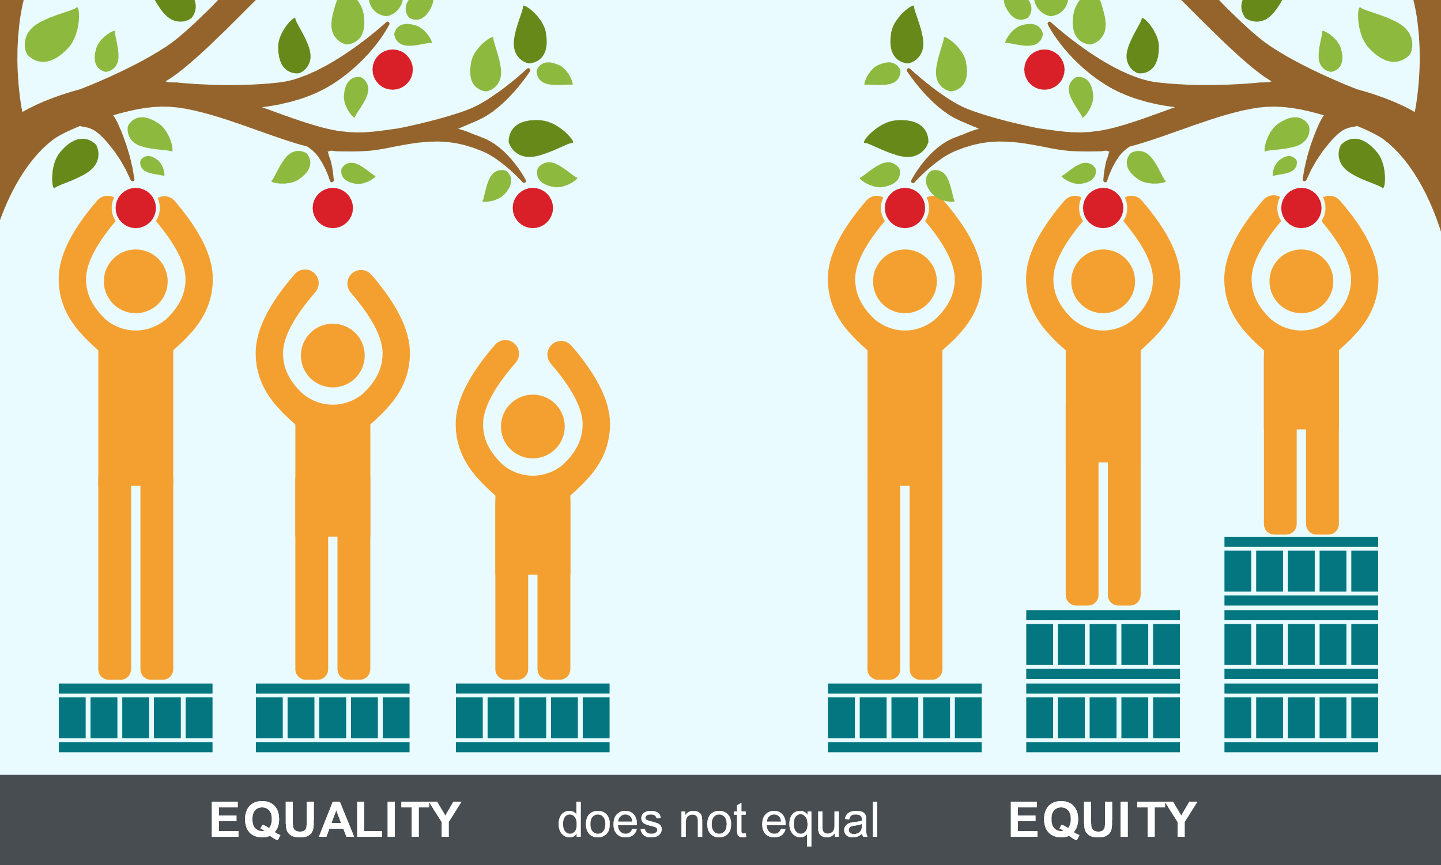
gender: 3 important terms
GENDER EQUALITY
GENDER EQUITY
GENDER MAINSTREAMING
Women & men have equal rights, life prospects, and opportunities to shape their own lives and contribute to society
Allocating resources, programs, and decision-making opportunities fairly, without any discrimination on the basis of gender
Addressing imbalances in benefits available to men and women
Process of assessing implications for women and men of any planned action, policy, or program, in all areas and at all levels before any decisions are made and throughout the whole process
definitions from
Mangroves for the Future
https://healthequity.globalpolicysolutions.org/about-health-equity/
Notes:
3 important terms related to gender are gender equality, gender equity, and gender mainstreaming. Perhaps you have heard these terms already, through the SRJS project or other trainings.
[Explain definitions and explain figure]
Gender mainstreaming is important for the SRJS projects – like many other donors, gender mainstreaming is a requirement for the projects that they fund.

Slide 8
gender & natural resource management
making decisions about natural resource management
selling natural resource products
extracting/ harvesting natural resources
using natural resource products in household
processing natural resources
Notes:
With this background on gender, let’s now take a simplified look at natural resource use and natural resource management (NRM).
In natural resource use, there are general types of activities that people engage in:
Extracting/harvesting resources
Processing these resources to make products
Using either raw or processed natural resources in households
Selling raw or processed products
Making decisions about how the managed natural resources, and how natural resources are used, processed, sold.
[NOTE: THIS TURNED OUT TO BE A CONFUSING WAY TO PRESENT THESE IDEAS. I SHOULD HAVE STARTED WITH DOODLING THESE STEPS/PROCESSES ON A BOARD, INSTEAD OF JUST EXPLAINING IN AN ABSTRACT WAY]

Slide 9
gender & natural resource management
making decisions about natural resource management
how do the experiences of women and men differ in these key steps of natural resource use?
selling natural resource products
extracting/ harvesting natural resources
using natural resource products in household
processing natural resources
Notes:
When we think about gender and NRM, we need to consider: how do the experiences of women and men differ in these activities?
There are more specific questions that are related to this general question:

Slide 10


making decisions about natural resource management
What do they do in each of these steps?
selling natural resource products
extracting/ harvesting natural resources
using natural resource products in household
processing natural resources
Notes:
1. For women and men: What do they do in each of these steps? What activities do they engage in? Who is doing what?

Slide 11
making decisions about natural resource management
time & resources to participate
What do they do in each of these steps?
position of authority
access to market
selling natural resource products
What helps/allows them to do this?
extracting/ harvesting natural resources
access to natural resources
access to capital/credit, equipment, training
using natural resource products in household
processing natural resources
Notes:
2. What factors help or allow women and men to do these activities?
For example, to extract natural resources, women and men need access to those resources. How does this differ between men and women?
It is also important to have access to capital or credit, equipment, training, and other services that help you extract resources, process resources, use resources, and sell them in the most beneficial way.
If you are selling these resources, you need to have access to the market – to fair prices, to consumers, to places where you can sell.
For making decisions, you need to have the time and resources to fulfill the role. If you are too busy, or desperate to earn money, you probably won’t be able to make time to participate. Similarly, if you are in a position where people listen to you, you will be more able to play a decision-making role.

Slide 12
making decisions about natural resource management
What do they do in each of these steps?
selling natural resource products
What helps/allows them to do this?
extracting/ harvesting natural resources
What do they gain from doing this?
gain knowledge, experiences
benefits –
income, food, etc.
using natural resource products in household
processing natural resources
Notes:
3. What are the benefits that women and men gain from their natural resource activities?
They gain knowledge and experience about these activities. People who do not do the same activities will not possess the same skills, understanding, and information.
They also benefit from how natural resources help them meet their needs, through income, food, etc.

Slide 13
making decisions about natural resource management
What do they do in each of these steps?
selling natural resource products
What helps/allows them to do this?
extracting/ harvesting natural resources
What do they gain from doing this?
pressures, challenges, physical risk,
vulnerability
using natural resource products in household
dependence on natural resources
What are difficulties for them?
processing natural resources
Notes:
But, women and men also face difficulties related to NRM.
In each step, activities carry certain risks – for example, physical risk to safety and health, or loss of income due to unexpected circumstances. They also come with pressures – pressure to supply enough resources to support a family, to commit time to being on a committee, to balance making a living with taking care of children and elderly family members.
Vulnerability is related to how
Being highly dependent on a limited # of natural resources is another cause of vulnerability. We will discuss this more, later.

Slide 14
BARRIERS
What do they do in each of these steps?
Activities, Roles, & Responsibilities
What activities are women not a part of?
What helps/allows them to do this?
Access, Rights, &
Capacity
What access, rights, & capacity do women lack?
What do they gain from doing this?
Knowledge, Benefits
What benefits do women not receive?
What are difficulties for them?
Pressures, Dependence, Vulnerability
What prevents women from doing these activities?
Notes:
We should consider all of these question. These questions are related to key topics: activities, roles, and responsibilities; access and capacity; knowledge and benefits; access, rights, and capacity; knowledge and benefits; pressures, dependence, and vulnerability.
When thinking about these topics, we can also think about “barriers” and what women do not have.
So, what activities are women not a part of?
What access, ... [read all red-box questions]

Slide 15
OPPORTUNITIES
What do they do in each of these steps?
Activities, Roles, & Responsibilities
What activities do women want to do?
What roles would allow women to better help their communities?
What helps/allows them to do this?
Access, Rights, &
Capacity
How can women’s capacity be improved?
How can women’s rights be strengthened?
What do they gain from doing this?
Knowledge, Benefits
What unique knowledge can women offer?
How can benefits to women & communities be increased?
What are difficulties for them?
Pressures, Dependence, Vulnerability
How can pressures and vulnerability be reduced?
How can women be empowered?
how can we remove barriers?
Notes:
On the other hand, we should also consider the OPPORTUNITIES to remove these barriers.
So, what activities do women want to do? [etc. – read questions in green]

Slide 16
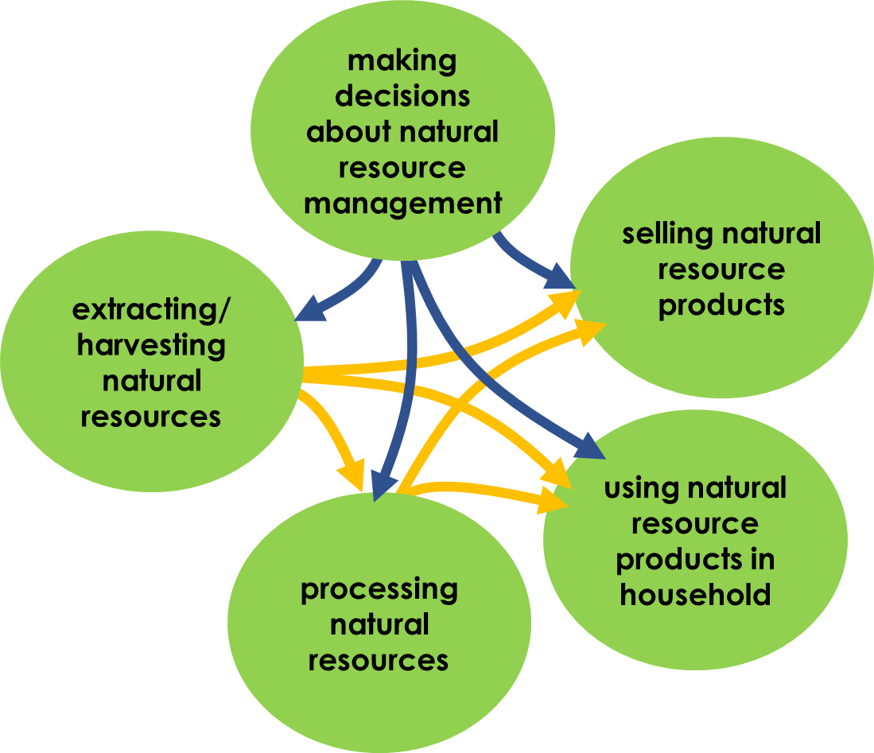
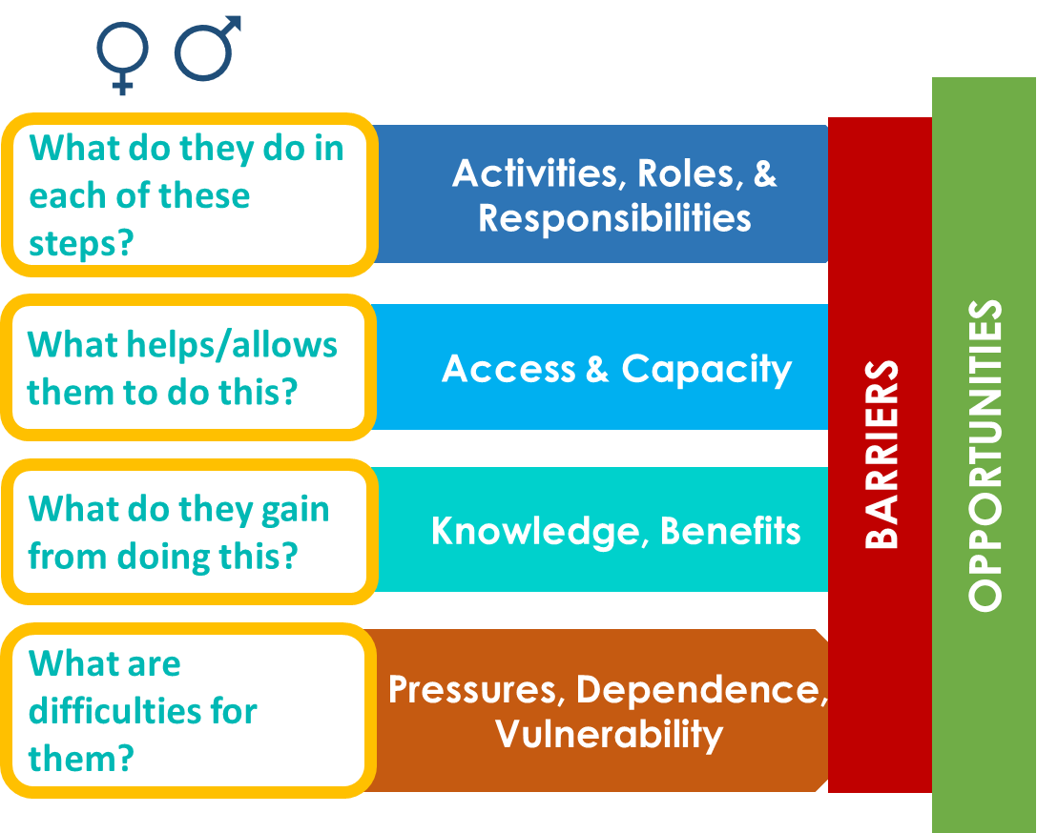
gender & natural resource management
how do the experiences of women and men differ in natural resource use?
how do these differences affect women, men, communities?
what do these differences mean for natural resource management?
why do differences exist?
Notes:
Considering these topics for all steps of natural resource use and management will help us understand the key question I mentioned earlier: how do the experiences of women and men differ in natural resource use?
With this question, we should also ask:
How do these differences affect women and men, as well as their communities?
What do these differences mean for natural resource management?
Why do these differences exist?
To understand these questions, we also need to understand gender roles and interactions beyond NRM. For example, what are the child-care and housekeeping roles of women and men? What are the responsibilities for providing income/food? What access to education and trainings do women and men have?
These questions are all important to consider in your work in communities. If you can find information to answer these questions, you will be better able to support communities working toward improved NRM and to support women and men in these communities. We will return to these questions later.

Slide 17
gender & natural resource management
to understand these, also need to understand gender roles and dynamics beyond NRM!
e.g.,
child-care/housekeeping roles
providing income/food
opportunities for education & training
how do the experiences of women and men differ in natural resource use?
how do these differences affect women, men, communities?
what do these differences mean for natural resource management?
why do differences exist?
Notes:
Considering these topics for all steps of natural resource use and management will help us understand the key question I mentioned earlier: how do the experiences of women and men differ in natural resource use?
With this question, we should also ask:
How do these differences affect women and men, as well as their communities?
What do these differences mean for natural resource management?
Why do these differences exist?
To understand these questions, we also need to understand gender roles and interactions beyond NRM. For example, what are the child-care and housekeeping roles of women and men? What are the responsibilities for providing income/food? What access to education and trainings do women and men have?
These questions are all important to consider in your work in communities. If you can find information to answer these questions, you will be better able to support communities working toward improved NRM and to support women and men in these communities. We will return to these questions later.

Slide 18
gender & natural resource management
→ how can a gender-inclusive approach to NRM benefit communities?
→ how can we learn more about gender and NRM in project sites?
→ how can we ensure that gender is incorporated in project activities?
→ how can we ensure that gender is incorporated in NRM in project sites?
Notes:
In this workshop, we will learn more about gender perspectives and the importance of gender in NRM. We will also learn how to study gender issues in communities. This is a very big and important topic, so it is difficult to cover it completely. However, we hope you will gain a greater understanding of gender in NRM and how to implement gender mainstreaming in your projects.
So, good questions to keep in mind during this workshop and during your work in communities are:
[Read questions in yellow box]

Slide 19
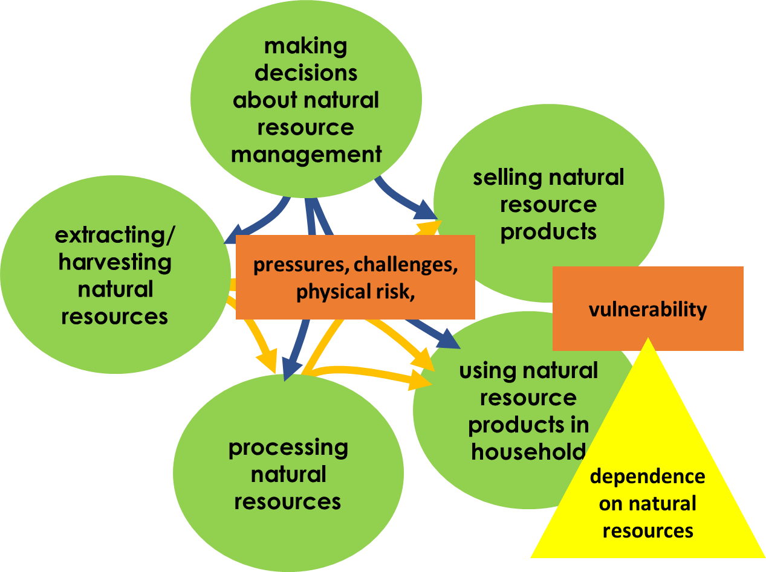
Key idea:
VULNERABILITY
Exposure to risk
Sensitivity
Capacity to adapt
For example:
Physical risks
Financial risks
Emotonal risks
Natural disasters
Conflict
e.g. High dependence on a certain resource
Resources
$
Information
Skills
Alternative job options
Ability to change activities
What might make a woman/man vulnerable in a natural resource use context?
activity: VULNERABILITIES & STRENGTHS
Notes:
A key idea to explain more is VULNERABILITY.
Vulnerability means the chance that you will be seriously, negatively affected by a harmful event.
It is related to your Exposure to Risk. For example, if your job involves risk of physical injury, you are exposed to that risk for many hours of the week – so, your exposure is high.
It is also related to Sensitivity. For example, if you are highly dependent on only a few resources, you have high sensitivity to the state of those resources – if they decrease, you are very vulnerable to negative impacts.
Vulnerability is also affected by your capacity to adapt. So, if a negative event happens to you, how can you improve your situation? Having access to resources like money, information, alternative job options, and other ability to change your activities means that you can adapt to negative events, and so are less vulnerable.
So, I would like you to think: What might make a women vulnerable in natural resource use? What might make a man vulnerable? Discuss this in small groups and write down 3-5 things that might make a women vulnerable, and 3-5 that might make a man vulnerable
[5-10 minutes; SHARE]

Slide 20
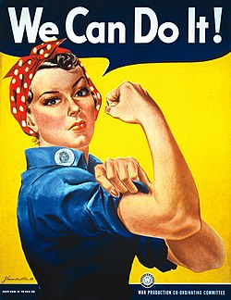
Key idea:
AGENTS OF CHANGE
Women are not just vulnerable “victims,” but also “agents of change”
Gender equality benefits communities
When women are more educated and empowered, economies & community well-being grows
  Greater sharing in problem solving
  More opportunities for all
  Benefits for children
    reduced child mortality
    improved health & opportunities → better quality of life for future generations
Enhances economic development
Improved prospects for future generations
Strengthened political & social systems
Notes:
Vulnerability is important to consider, but it is also important to realize that women are not just vulnerable victims – they can be strong and capable agents of change.
Gender equality has been shown to benefit communities and society.
[Read green boxes & text below them]
Sources: World Bank, UN Women, OECD; child mortality – Gakidou et al. 2010

Slide 21
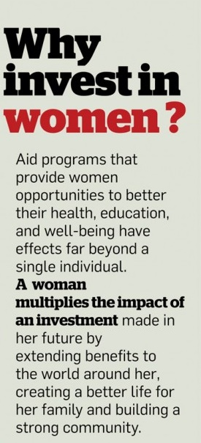
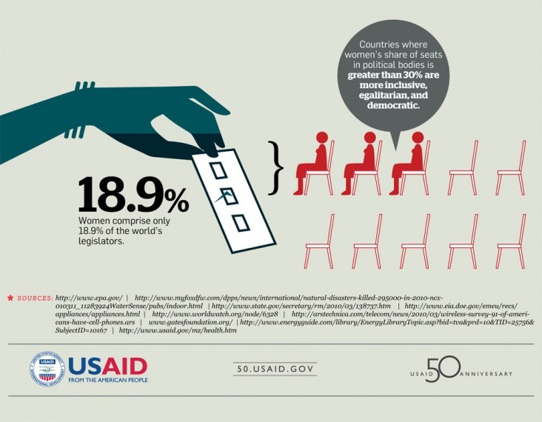
Key idea:
AGENTS OF CHANGE
Notes:
Here are some more examples of gender equality benefitting communities.
Women tend to share benefits with people around them, starting with their families.
Countries where women have >30% representation in political bodies are more inclusive, have greater equality, and are more democratic.

Slide 22
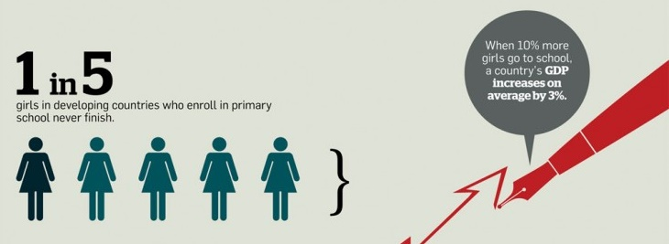
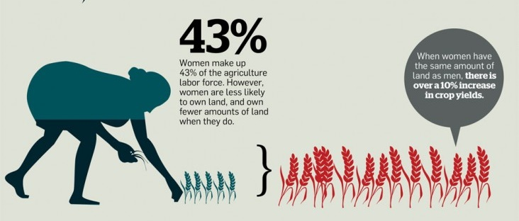
Key idea:
AGENTS OF CHANGE
What are strengths that women/men have that might help their communities improve NRM?
activity: VULNERABILITIES & STRENGTHS
Notes:
When 10% more girls go to school, a country’s economy increases on average by 3%.
When women have the same amount of land as men, there is over a 10% increase in crop yields.
So, thinking about strengths: What are strengths that women have that might help their communities improve NRM? What are strengths that men have? Write down 3-5 points for each in your groups.
[GROUPS WRITE DOWN; SHARE]

Slide 23





Example:
COLLECTING FUEL FOR COOKING
Walk to the forest to collect wood
Cook food inside over stove
think: VULNERABILITIES & STRENGTHS for this case study
vulnerability
natural resource management?
solutions?
role of women in solutions?
Notes:
Here is an exercise for thinking about vulnerabilities and strengths in NRM.
In many places, women have to collect wood to use in cooking. They need to walk to the forest. Then they need to carry the wood back to their house, where they cook inside. In many place, they cook using basic stoves – which give off a lot of smoke and which have high risk of burns to people in the house.
In your groups, think about the vulnerabilities of women in this situation.
Think about how this is related to natural resource management.
Think about solutions that could help reduce this vulnerability.
And then, think about the role they could play in finding solutions to these vulnerabilities. [WE DID NOT HAVE TIME TO MAKE THIS A FULL ACTIVITY! SO I JUST SAID THAT THIS DEMONSTRATES MANY OF THE POINTS RAISED BY GROUPS FROM THE PREVIOUS SLIDE]
VULNERABILITIES:
exposure to assault
physical injury/discomfort
smoke – impacts on health
risk of burns
NRM:
wood collecting might negatively impact forests
Degradation to forests makes the work more difficult for women
SOLUTIONS:
fuel-efficient, clean-cook stoves
reforestation
ROLE OF WOMEN:
help in the design of the stoves
help design a way to reduce risk of attack

Slide 24
HOW MIGHT WOMEN & MEN HAVE DIFFERENT EXPERIENCES IN NRM ACTIVITIES? WHY?
activity: WORLD CAFE
Notes:
Now we return to the big topics about gender in NRM. For this activity, you will consider: how might women and men have different experiences in NRM activities? And why?
[explain World Cafe activity; should be 1 hour total:
5 groups, each assigned to 1 “step” (extract, process, use, sell, manage) to answer the 4 questions (activities, access, knowledge, pressures) and how women/men have different experiences
Start with 1 group writing out in detail on large paper for each of the 5 topics; use sticky notes
Then, cycle the large papers among groups, until each group has had a chance to put feedback on each of the 5 large papers
Then, the original group reviews feedback from other groups, with the help of facilitators, and then shares with whole grou]

Slide 25
gender &
natural resource management
WHY IS IT IMPORTANT?
Rights, Justice
Not just for women
Not against men
Women deserve equal chances to choose their life path.
Women depend on NR and should be a part of how they are managed.
Not just a “women’s issue”!
Men and women can benefit from gender inclusion in NRM
“2 wings of the same bird”
Women are ~50% of the population – if they do not have a voice, society loses opportunities for ideas, solutions, contributions to communities & NRM
Men & women can work together – as partners
Men as “gender champions” – to support women & help build capacity for NRM
What might be the benefits of including & empowering women in NRM decision-making?
activity: TOXIC WASTE!
Notes:
A common question is “why do we need to care about gender in NRM?”
Who can give me some reasons why gender is important in NRM?
A question of rights and justice
It is not just a “women’s issue” – as we saw earlier, men and women and children can benefit from gender inclusion in NRM.
It is not “against men” – in fact, men can play an important role to support the women in their communities. They can work together as partners. Men can be “gender champions” to help women improve in areas where they do not have experience – perhaps in leadership, or in public speaking. You cannot expect women to be strong in all of these areas if they have not had opportunities to do these things before, so men should be patient and supportive.
To demonstrate some of these points, we will do the Toxic Waste activity!
[Activity – groups try to transport a bucket of water attached to 5-6 ropes; this water is “toxic waste” that cannot be spilled, otherwise the community’s water will be contaminated:
Each rope is managed by 2 people: 1 person, blindfolded/eyes closed, holds the rope; while the other tells their blindfolded partner where to move/what to do
Each group of 10-12 people must transport the bucket to a target without spilling the bucket
NOTE: THIS ENDED UP BEING TOO EASY, AS THE GROUND IN THE TRAINING AREA WAS FLAT. RECOMMENDED TO ADD IN FAKE “BARRIERS” THAT PARTICIPANTS MUST AVOID]
Discussion:
How would this have been different if the partner did not help the blindfolded person?
How would this have been different if there were no blindfolds?
What does this show us about working together and building capacity?
How might this relate to gender in NRM?
Toxic Waste discussion points:
Working as a team is better
How would this be different if your partner did not explain to you?
How would this be different if everyone were able to see?

Slide 26
gender &
natural resource management
HOW CAN MEN PLAY A ROLE IN SUPPORTING GENDER-INCLUSIVE NRM?
HOW CAN WOMEN PLAY A ROLE IN SUPPORTING GENDER-INCLUSIVE NRM?
DISCUSSION & SHARING
Notes:
Based on what we’ve learned and done so far, I would like you to go into groups to discuss:
How can men play a role in supporting gender-inclusive NRM?
How can women play a role in supporting gender-inclusive NRM?
(1 point: it is not just men who “prevent” gender equality; women also have tendencies to maintain the status quo)
[I had originally planned for these to be single-gender groups, but...I forgot! Benefit of single-gender groups is that each gender might feel more comfortable sharing.]

Slide 27
gender &
natural resource management
activities: UNDERSTANDING GENDER PERSPECTIVES & EXPERIENCES
Inequality game
“If I were the other gender, what could I do that I cannot do now?”
Perspectives about gender & skills
WHAT IS ONE IMPORTANT/INTERESTING THING YOU LEARNED TODAY?
Notes:
Now we will do some activities for you to think more about gender issues.
First, we have the inequality game. Let’s imagine we are in a community with 1 majority ethnic group, and small minority ethnic groups. Each of your five groups will be assigned an identity:
Male from the main ethnic group
Female from main ethnic group
Male from minority ethnic group
Female from minority ethnic group
Widow from main ethnic group
OK, now we will read out different scenarios that might happen. Based on these scenarios and on your gender, ethnicity, and marital status, you will either gain or lose points.
Development project comes to village, only meets with main ethnic group. Points: A – 5, B – 5, C- 0, D – 0, E - 5
Development project establishes management committee; only men are in decision-making positions. A – 5, B – 0, C- 0, D – 0, E - 0
Management committee meetings are held in early evening when women are cooking. A – 5, B – 3, C – 5, D – 3, E – 0 (because the widow has higher burder for housecare, she benefits less than other women)
Drought and people must find other livelihoods Negative points: A - -3, B - -5, C - -3, D – 5, E - - 8
Micro-credit project opens, women are more comfortable accessing it than men: A – 3, B – 5, C – 3, D – 5, E - 5
[DISCUSSION ON HOW THIS DEMONSTRATES DIFFERENT ADVANTAGES/DISADVANTAGES, AND HOW PROJECTS CAN AFFECT EQUITY ACROSS GENDERS AND ETHNICITIES, ETC.]
Now, I would like you to think: “If I were the other gender, what could I do that I cannot do now?”
Next, please fill out these anonymous questionnaires and return them to us tomorrow morning: For each statement, answer on a scale of 1-5 (1 – strongly disagree, 5 – strongly agree)
How much confidence do you have in the ability of a male leading a committee?
How much confidence do you have in the ability of females to lead to committee?
How much would you trust a man to repay money you loan him?
How much would you trust a woman to repay your loan?
How much confidence do you have in a male to responsibly run a project?
How much confidence do you have in a female to responsibly run a project?
How much confidence do you have in a woman to make good decisions for the community?
How much confidence do you have in a man to make good decisions for the community?
How much do you trust a man to invest money in his family and household?
How much do you trust a woman to invest money in her family and household?

Slide 28
gender & natural resource management
DAY 2

Slide 29
gender & natural resource management
How can we learn about gender & NRM in our project sites?
For this training, two types of questions:
Gender & NRM in communities
How SRJS partners address/include gender & NRM
in their work and organizations
HUMAN-CENTERED RESEARCH
Notes:
Today, we will go over how we can learn about gender and NRM in project sites.
There are 2 types of big topics you can study related to this:
Gender and NRM in communities
How your organization and project include gender and NRM in their work
For both of these topics, we can collect information using Human-Centered Research.

Slide 30
Research focused on people – their experiences, perspectives, needs
Goal: To understand the voices of your target group
HUMAN-CENTERED RESEARCH
Notes:
Human-centered research is focused on people – their experiences, perspectives, and needs.
The goal is to understand the voices of your target group.
Key values for this research are:
Mindfulness
Empathy
Optimism
Collaboration
Experimentation

Slide 31
Part of the DESIGN THINKING Process
A partipatory, creative process of designing solutions, focusing on the needs of the target user
Now being applied to community solutions and conservation
HUMAN-CENTERED RESEARCH
Notes:
Human-centered research is part of the Design Thinking Process.
This is a partipatory, creative process of designing solutions, focusing on the needs of the target user

Slide 32




Inspiring a New Era of Possibility
We are non-profit organization created to infuse new ideas, tools + processes into humanitarian development in Myanmar
Design-Thinking Center for
Community Engagement
Develop Multi-Ethnic Changemakers
Introduce a Design-Thinking Process
Create platforms for Collaboration
Prototype to discover new Solutions
Enhance Value of Mawlamyine University
HUMAN-CENTERED RESEARCH
Point B Design + Training
DESIGN CHALLENGE (1 hour)
Notes:
Our organization, Point B, focuses on training people in Design Thinking approaches. If you want to know more about this, please come talk with us – we are happy to share information!
To demonstrate what Design Thinkinig is, we will now do a DESIGN CHALLENGE.
[DESIGN CHALLENGE ACTIVITY]

Slide 33
How can you collect the information that you need?
Build a Research Toolkit
Focus: What topics do you want information on?
How will you get that information?
  Who do you need to get information from? Stakeholder analysis
  What tools would be appropriate? Interviews, focus groups, participatory activities
  How should you approach your respondents?
Notes:
So, when you are using human-centerd research, you need to collect information.
How can you collect the information that you need? You build a research toolkit.
First, focus on what topics you want information on.
Then, think about how you will get that information –
Who do you need to get info from?
What tools are appropriate?
How should you approach respondents?

Slide 34
How can you collect the information that you need?
Build a Research Toolkit
METHODS
Diverse tools!
Should encourage reflection, sharing of ideas
Focus on the user’s perceptions, needs, stories
INTERVIEWS
GROUP DISCUSSIONS
ACTIVITIES
HUMAN-CENTERED RESEARCH
Notes:
There are many tools that you can use. The tools you choose should
Should encourage reflection, sharing of ideas
Focus on the user’s perceptions, needs, stories
Tools can be interviews, group discussions, and activities. Activities can be integrated/included in interviews and group discussions.

Slide 35
How can you collect the information that you need?
Build a Research Toolkit
Examples of tools:
Gender and Resources mapping
Seasonal calendar (as capture sheet)
Notes:
Some examples of tools include:
Gender and resources mapping – this means you draw on a map where resources are, and the activities that different genders do with them.
Seasonal calendar – this is a way you can record information about gender and activities throughout the year – see next slide for example

Slide 36
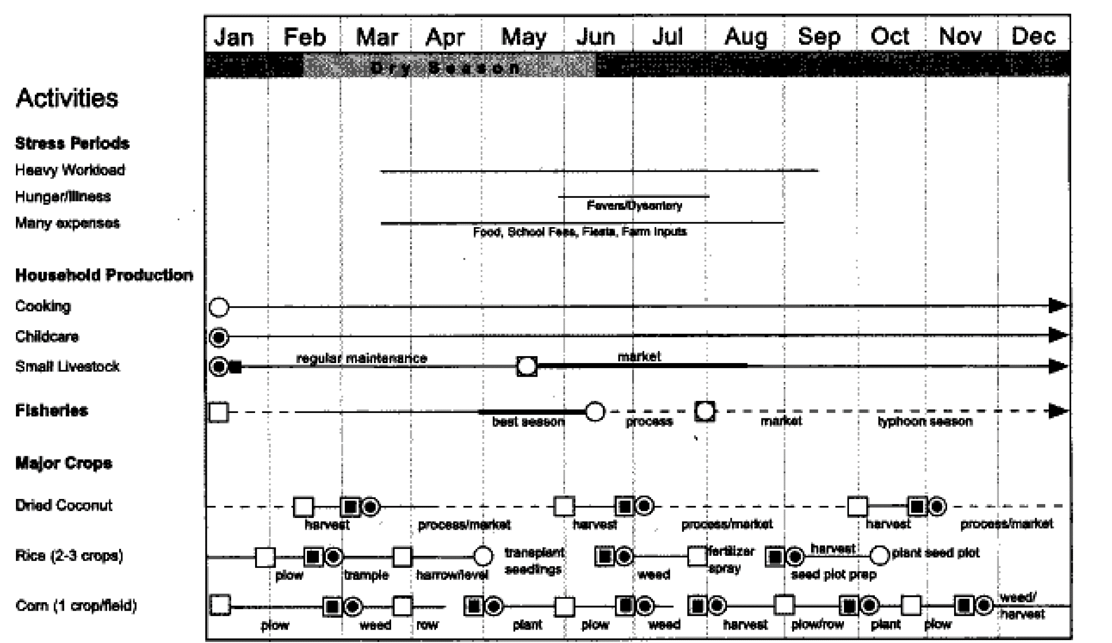
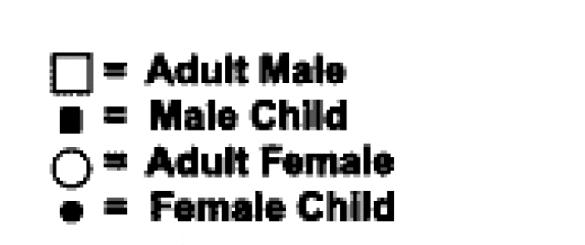
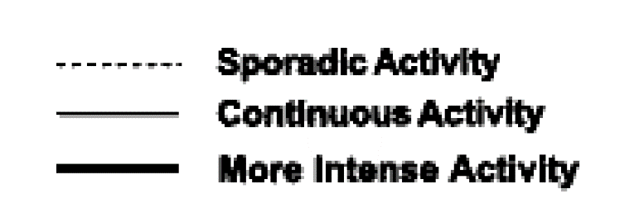
How can you collect the information that you need?
Build a Research Toolkit
Notes:
[explanation of this figure – seasonal calendar]

Slide 37
How can you collect the information that you need?
Build a Research Toolkit
Examples of tools:
Gender and Resources mapping
Seasonal calendar (as capture sheet)
Journey Map
Ranking game – importance of resources
While conducting interviews: Need to consider “Questioning skills” (go to Questioning skills powerpoint slides)
demonstration: Ranking Game
activities: Journey Map
Notes:
Then, there is the journey map. This is a way to record a person’s experiences and feelings throughout the day, or throughout a process
There is also the ranking game, which you can use to establish the importance of resources.
Whenever you are using these tools in interviews, you need to consider “Questioning Skills” [Point B’s “Questioning Skills” slides]

Slide 38
How can you collect the information that you need?
Build a Research Toolkit
Important to consider:
  Bias
  Memory
  Shyness/unwillingness to share with interviewer/facilitator
  Group dynamics in group discussions/activities
  Ability for respondents to understand your toolkit
  Sensitive topics
  Clear introduction statement
  Non-judgmental responses
  Do not lead the respondent
Notes:
When you are designing your toolkit and your interview questions, these are important things to keep in mind:
Important to consider:
Bias
Memory
Shyness/unwillingness to share with interviewer/facilitator
Group dynamics in group discussions/activities
Ability for respondents to understand your toolkit
Sensitive topics
Clear introduction statement
Non-judgmental responses
Do not lead the respondent

Slide 39
gender research
Build a Research Toolkit
1-day project:
Choose a (small) topic related to gender
Choose tools to collect info. on this topic
Notes:
Now, we will build a toolkit for a small research project that we will do tomorrow. You will normally want to do much more in-depth work to get good understanding of a research topic, but for this class, we will just do a very short project.
In 5 groups, you will choose a simple, small topic related to gender. [key question: Do we go to market, or do research among participants?]
This topic should be simple enough that you can collect good information on it in ~2 hours.
Then, choose tools that you can use to collect information on this topic – design a toolkit.
We will help you with this!
Later, we will test and share our toolkits, to make them ready to use tomorrow morning.

Slide 40
gender & natural resource management
DAY 3

Slide 41
gender research
Conduct Research
Synthesize Findings
Present & Discuss
What are recommendations based on this research? How would you improve this research? How could this inform your CSO’s activities with the community on NRM?
Notes:
9 to 9:30 – finish toolkits
9:30 to 10:30 – Groups 1 and 2 interview Groups 3 and 4
10:30 to 10:45 – Break
10:45 to 11:50 – Groups 3 and 4 interview Groups 1 and 2
After lunch:
The research process goes from designing your research project – which you did yesterday – to conducting research. Then, you find out what the information you collected means – you can call this data analysis or synthesizing findings. This can be qualitative or quantitative.
Then, you present your findings and discuss what they mean.
[Yin Yin explanation of qualitative synthesis of findings]
[Groups present their question, toolkit, and findings]

Slide 42
gender & natural resource management
DAY 4

Slide 43
gender research
Conduct Research
Qualitative
Synthesize Findings
Quantitative
Present & Discuss
What are recommendations based on this research? How would you improve this research? How could this inform your CSO’s activities with the community on NRM?
Notes:
First, I want to point out that tomorrow will only be a half-day – we will finish at noon!
Thank you all for your excellent presentations yesterday – you all had interesting research questions and findings!
I want to briefly introduce the difference between qualitative and quantitative data. You do not need to understand this in detail now, but this is just to let you know that there are different types of information that you can use when studying gender (or other topics).
Qualitative data is what most of you used yesterday in your research.
Quantitative deals with measuring or presenting things as numbers. For example, the % of women and men who engage in an activity, or the % of people who gave a certain response to a question, or the average income of a household.
There are different ways to analyze these kinds of data. Even though the data you collected yesterday way qualitative, it was still very valuable – people’s perspectives, stories, and experiences are critically important in issues such as gender equality.

Slide 44
gender research
To consider:
Sample size (how many people you interview) Representative sample Keeping focus! But also, being adaptable Keeping your mind open for alternative explanations Digging deeper into unexpected results Think: What are my own biases? What might I be missing?
Notes:
Based on your shared research yesterday, I wanted to share some basic tips for research.

Slide 45
gender &
natural resource management
in SRJS Project Communities
Notes:
Now, let’s come back to the idea of gender and NRM in your project communities.
Here again is the figure we presented in Day 1, on the different types of activities related to NRM and the different things to consider for each type.

Slide 46
gender &
natural resource management
in SRJS Project Communities
 | Extracting |  | Processing |  | Using |  | Selling |  | Making Decisions
Activities, roles, responsibilities
Access, rights, capacity
Knowledge, benefits
Pressures, Dependence, Vulnerability
BARRIERS
OPPORTUNITIES
What do you know already?
Notes:
Let’s put this in table format.
In your groups, please fill out what you know about gender roles and experiences in NRM by filling out this table to the best of your ability. If you do not have information on a topic, it is ok to leave it blank or write “don’t know”
[MAKE A TABLE]

Slide 47
gender &
natural resource management
in SRJS Project Communities
 | Extracting |  | Processing |  | Using |  | Selling |  | Making Decisions
Activities, roles, responsibilities
Access, rights, capacity
Knowledge, benefits
Pressures, Dependence, Vulnerability
BARRIERS
OPPORTUNITIES
What do you know already?
Complete this based on what you know now
Notes:
[QUICK PRESENTATIONS FROM THE GROUPS]

Slide 48
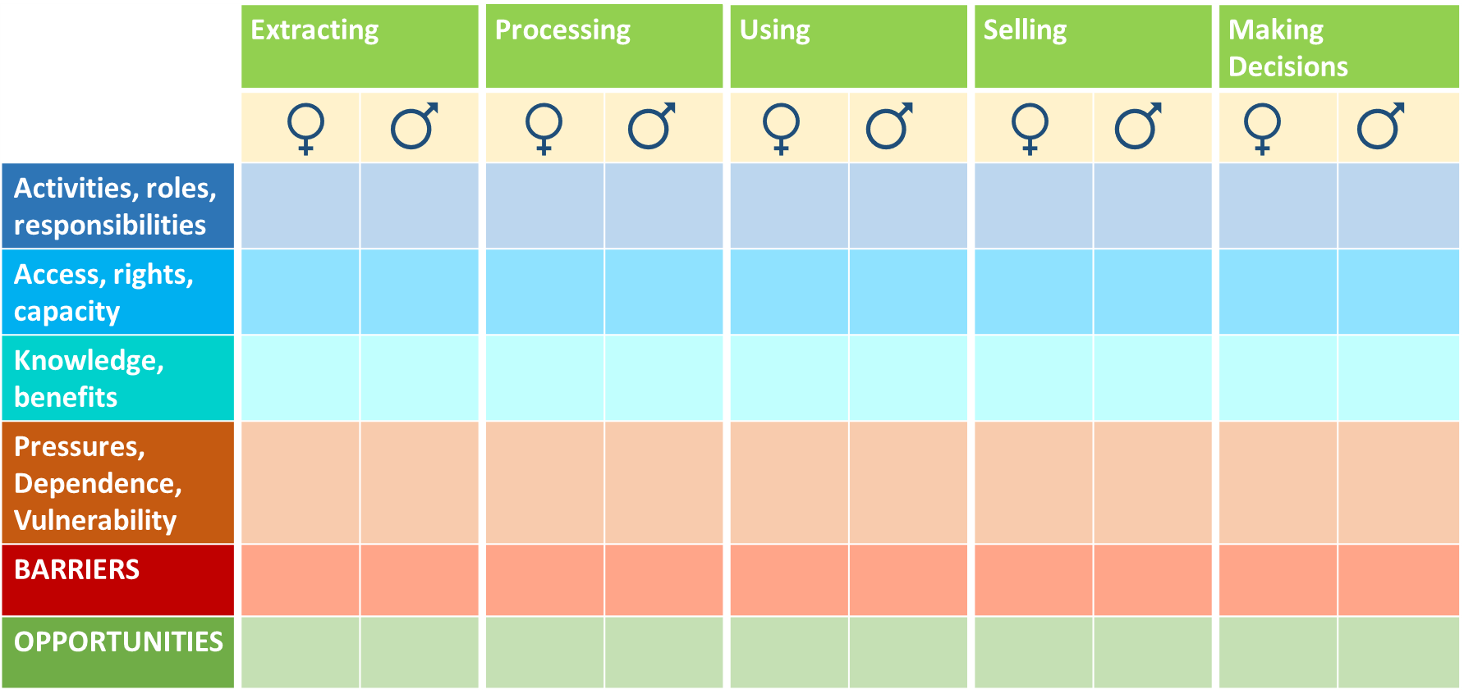
gender &
natural resource management
in SRJS Project Communities
What are priority issues/questions?
What is missing??
Notes:
Filling this table is actually a big task! Don’t worry if you are not able to finish it here. We just want you to get some experience identifying what you know already about gender in NRM in your communities. This can be a good place to start thinking about what are important issues about gender and NRM, and about what information you still need to collect!

Slide 49
gender &
natural resource management
in SRJS Project Communities
What are priority issues/questions?
What is missing??
Ideas for toolkits:
Activities/tools/skills you’ve learned from this workshop
Toolkits published by gender projects
Toolkits for general community research, adapted for gender questions
For example...
Develop a research/assessment plan & toolkit
Notes:
Then, once you have identified your priority questions, you can develop an assessment or research toolkit – similar to the process we went through yesterday. It is possible that we (Point B and IUCN ARO) will help you do gender analysis work – so, we would go through this process together.
These toolkits can include anything you’ve learned in this workshop, but there are also a lot of other toolkits published by projects. I recommend learning from these.

Slide 50
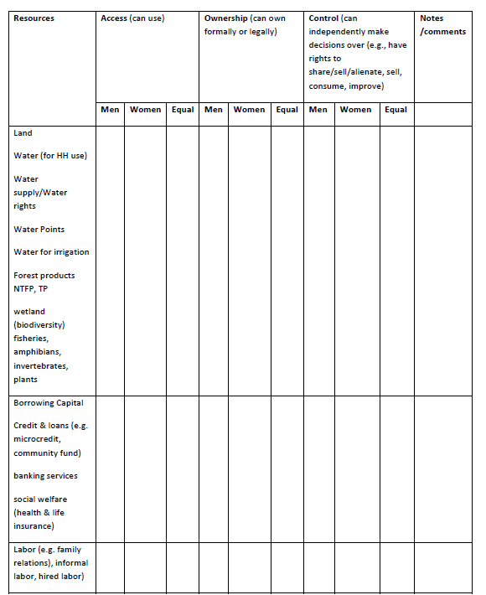
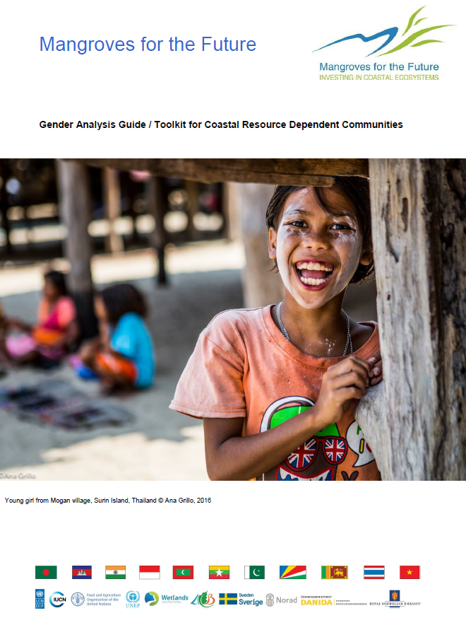
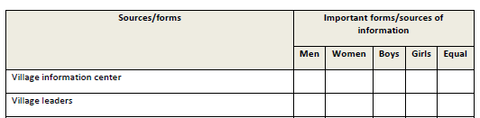
gender &
natural resource management
in SRJS Project Communities
Notes:
One toolkit is by Mangroves for the Future [go to MFF Gender Analysis Guide, show different tables and question guides]
I strongly recommend you look through this for ideas on how to better understand gender.

Slide 51
gender &
natural resource management
& projects
2 ways to include Gender in projects on NRM
Include gender issues in your work in communities & policy
Gender assessments/research
Gender trainings
Engage women
Remove barriers to women participating in your project
Are women and men involved in project activities? how?
Are there barriers to women being more involved? What?
What are impacts of project activities on women and men? Why?
Notes:
So, we have reviewed a lot about gender in natural resource management, and have learned more about how to study gender issues.
Now, we will go over how you can include gender in your natural resource management projects. There are 2 ways to do this:
Include gender issues in your work with communities and policy.
This includes gender assessments and research to understand gender dynamics in your project communities. This is what our training has focused on so far.
This also includes gender trainings for the communities.
You can make sure that women are engaged in your project activities.
You can help remove barriers to women participating in your project. As many of you have mentioned, an example is making meeting times when women can attend. Another suggestion that we have heard is providing child care during the meetings.
Also, you can make sure that you have female facilitators from your project, so that women feel comfortable talking with them.
Questions to keep in mind when you are planning or evaluating your activities are:
(Read the 3 questions on the bottom of the slide)

Slide 52
gender &
natural resource management
& projects
2 ways to include Gender in projects on NRM
Include gender issues in your work in communities
Gender trainings
Gender assessments/research
Engage women
Remove barriers to women participating in your project
Include gender issues in your organization
Is there equality between genders in your organization?
Gender-balanced staff roles?
Gender focal point
Notes:
The other way to include gender in your work is within your organization.
Is there equality between genders in your organization?
Are there gender-balanced staff roles? We will talk about this more, later.
Is there someone in your organization who can act as a gender focal point? This means, one of their responsibilities is making sure that your organization and your activities are gender-inclusive.
[HELIUM STICK EXERCISE: Using a light stick (e.g., large sheet of paper rolled up), have teams of ~8-12 stand in two rows facing each other. Each person helps hold up the stick with their index fingers. The goal is for the group to bring the stick gently to the ground, all at the same time, holding it on their index fingers – and only their index fingers! – the whole time.
Usually, groups will find that the stick seems to magically rise – this is due to the cumulative effect of individuals being afraid to drop the stick. With coordination, teams should be able to gain confidence in each other and work together (e.g., counting to 3 and lowering at the same time) to succeed
Discussion points:
Why was this activity challenging?
How was your group able to succeed in the end?
How can this relate to gender inclusion in your work? – possible points include coordination, trust, managing fears, etc.]

Slide 53
gender &
natural resource management
& projects
Why do you need to do this?
Ideas from group?
1. Ethically correct
2. Improves effectiveness
3. Donors & organizations want it!
Notes:
So, why do you need to include gender issues in your project and your organization?
As we have discussed already, this is the ethically right thing to do.
Also, it will likely benefit your organization, your project, and the project communities – as we reviewed, including women is usually beneficial for communities. Their contributions are valuable.
And, this is now a priority for many funders/donors and organizations. Gender mainstreaming is a requirement in many project grants. So, if you want to satisfy your donors, and also to be more attractive to future donors, it is wise to include gender in your work. (Hopefully, that is not your only motivation!)

Slide 54
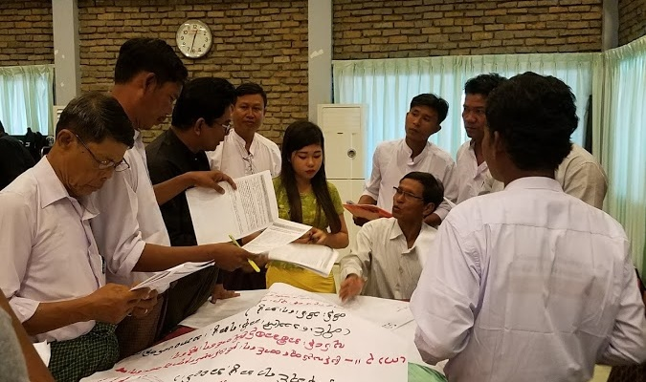
gender &
natural resource management
& projects
What do you notice about this photo from a project meeting?
Notes:
So, let’s look at this photo from a project meeting with community members. What do you notice?
(1 woman) ← she is a note-taker
What do you think about this? Why?

Slide 55

What does “inclusion” mean?
gender &
natural resource management
& projects
“DECISION-MAKING MEETING” EXERCISE
LAKE 2
E
A
F
D
B
LAKE 1
C
Notes:
When you have activities, it is important to think about what “inclusion” and “participation” really mean. To demonstrate this, we will play a role-playing game! We need 6 volunteers (or we randomly choose).
Each of you is assigned a role.
A: you organized the meeting and you are in charge of the agenda.
B: you are an influential person in the community, and you can make decisions.
C: You speak at the meeting, and everyone listens to your ideas
D: You try to speak, but nobody listens to you.
E: You attend, but you do not do anything.
F: You cannot attend the meeting because you have to take care of your children. Please sit outside.
Everyone else, you will act as the other participants of the meeting.
[Dialogue on the next slide]

Slide 56
Topic: Deciding on a water improvement project in Lake A, to make water access easier (pipe to a faucet); users will pay a fee, which will go into a community development fund for maintenance of the water system - and other activities. Lake B is another lake on the other side of the village. To make the project in Lake A feasible, resources will no longer be spent to maintain Lake B. Roles A: You organized the meeting and you are in charge of the agenda, and you live near Lake A B: You are an influential person in the community, and you can make decisions; live near Lake A C: You speak at the meeting, and everyone listens to your ideas; live near Lake A D: You try to speak, but nobody listens to you; you live near Lake B E: You are ethnic minority, not comfortable with the main language, feel very shy; live near Lake B F: You cannot attend the meeting because you have to take care of your children. Please sit outside.
A: | Hello, everyone, I would like to start this meeting. We are here to discuss approval for the water improvement project in Lake A. First, I would like to hear if there are any objections to this project?
D: | I am unhappy with the project! I don't want to have to go all the way to Lake A to get water, and I don't want to pay! And now, the water in Lake B will be worse --
C: | [Interrupts D] Yes, but many people will be happy with the water from Lake A, and it will be healthier than Lake B's water is now.
E: | [Throughout the rest of the meeting, raises hand, then stands up and tries to speak, and gets shy and sits down] All other actors ignore E
B: | That's right, I agree with C.
A: | Any other objections?
D: | What about for those of us by Lake B?
A: | OK, we are out of time to talk about objections! We should now focus on planning when the project starts.
B: | It should start within the next 2 weeks to give us time to finish long before dry season begins.
D: | But...!
A: | No, sorry, no time for objections! I agree with B, we will write his decision in our meeting minutes, and move forward with his plan!
Notes:
Have the volunteers practice this dialogue away from the main group. Encourage them to really embrace the role!
Then, when done, ask the different volunteers how their character felt. Did they feel included? Frustrated? Empowered, or weak?

Slide 57
What does “inclusion” mean?
gender &
natural resource management
& projects
“DECISION-MAKING MEETING” EXERCISE
A. moderates
B.
makes decisions
speaks
E.
attends, does not participate
F.
cannot attend
C.
listened to
D.
ignored
Notes:
When you have activities, it is important to think about what “inclusion” and “participation” really mean. To demonstrate this, we will play a role-playing game! We need 6 volunteers (or we randomly choose).
Each of you is assigned a role.
A: you organized the meeting and you are in charge of the agenda.
B: you are an influential person in the community, and you can make decisions.
C: You speak at the meeting, and everyone listens to your ideas
D: You try to speak, but nobody listens to you.
E: You attend, but you do not do anything.
F: You cannot attend the meeting because you have to take care of your children. Please sit outside.
Everyone else, you will act as the other participants of the meeting.
[WE WILL EXPLAIN RULES MORE... ONCE TARA COMES UP WITH THEM!]

Slide 58
gender &
natural resource management
& projects
How can you encourage/facilitate gender inclusion in projects?
Ideas from group?
  Female staff
  Enabling and encouraging women’s participation
    Separate gender groups + integrated groups
    Active involvement in participatory activities
    Learn when women can participate, and under what conditions
    Learn where women get their information, and use that to communicate with them
  Ensuring that women’s voices are heard
  Ensuring that women are in decision-making positions
  Ensuring that women and men enjoy benefits
  Ensuring that women and men are not negatively impacted
  Raising awareness among women, men, girls, boys
  Building capacity among women – and access to opportunities
Notes:
So, I would like to hear your ideas for how you can encourage and facilitate gender inclusion in projects:
[Ask participants to give ideas]
Great! Here is a list of suggestions: (go through list)
It is important to realize that gender roles can be a sensitive topic. So, you need to be aware of social norms and how strong they are. It is important to realize that you might not be able to change the community very much in some ways. You might end up causing conflict if you help certain groups and other groups do not like it. So, it is very very important to build trust with the community, and to make sure that any changes you work for are changes that community members want.
Another good thing to keep in mind is the legal context for gender issues. I am not so familiar with this in Myanmar (we will talk a little more about gender in policy in Myanmar). But, it is important that women and men are equally aware of their legal rights in natural resource management.
You might identify areas where women and men need stronger rights, or where their issues need greater inclusion in policies. These are important areas of work – as the DDA and MLN participants know!

Slide 59


gender &
natural resource management
& projects
How can you encourage/facilitate gender inclusion in projects?
Concerns: conflict, changing social norms, sensitive topics
→ Requires strong trust-building, sensitivity
Legal awareness & links to policies/regulations
→ One approach toward empowerment – ensuring women know their rights!
Notes:
So, I would like to hear your ideas for how you can encourage and facilitate gender inclusion in projects:
[Ask participants to give ideas]
Great! Here is a list of suggestions: (go through list)
It is important to realize that gender roles can be a sensitive topic. So, you need to be aware of social norms and how strong they are. It is important to realize that you might not be able to change the community very much in some ways. You might end up causing conflict if you help certain groups and other groups do not like it. So, it is very very important to build trust with the community, and to make sure that any changes you work for are changes that community members want.
Another good thing to keep in mind is the legal context for gender issues. I am not so familiar with this in Myanmar (we will talk a little more about gender in policy in Myanmar). But, it is important that women and men are equally aware of their legal rights in natural resource management.
You might identify areas where women and men need stronger rights, or where their issues need greater inclusion in policies. These are important areas of work – as the DDA and MLN participants know!

Slide 60
gender & natural resource management
DAY 5

Slide 61
gender &
natural resource management
& projects
How can you encourage/facilitate gender inclusion in projects?
COMMUNITY ENGAGEMENT ACTIVITIES
Ideas for activities:
Activities you’ve learned from this workshop
Guides published by gender projects
Guides for general community engagement, team building, etc., adapted for gender issues
For example...
Notes:
You can use the activities that we have used in this training to work with communities on gender issues. There are also toolkits available online for these trainings.

Slide 62
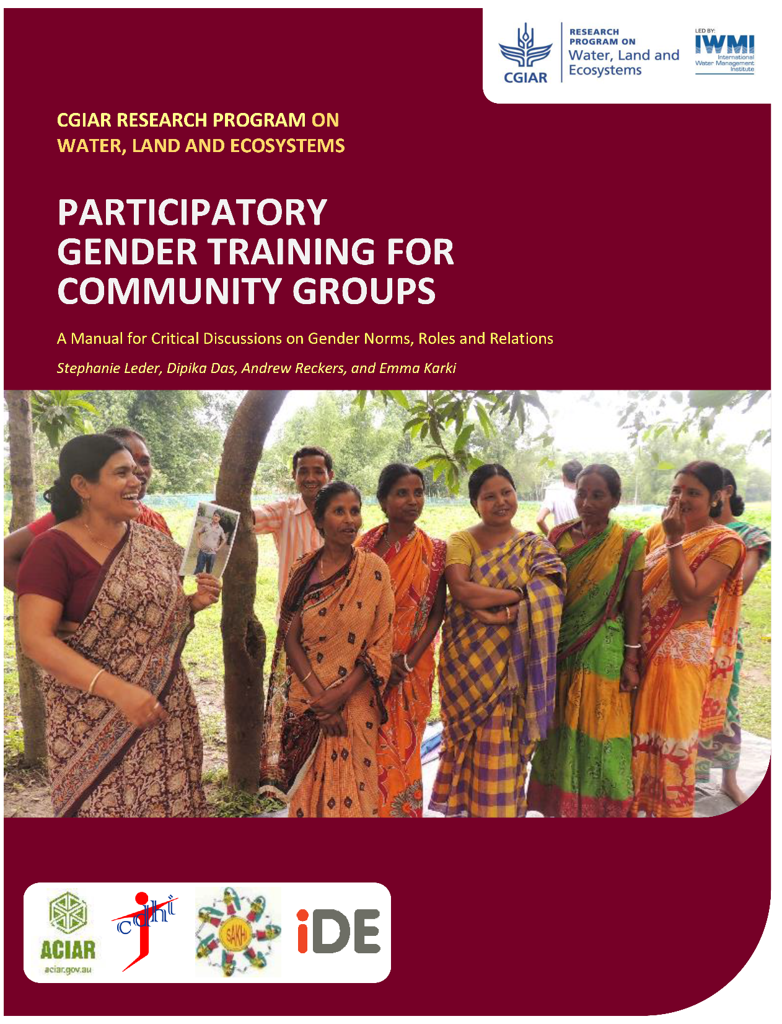
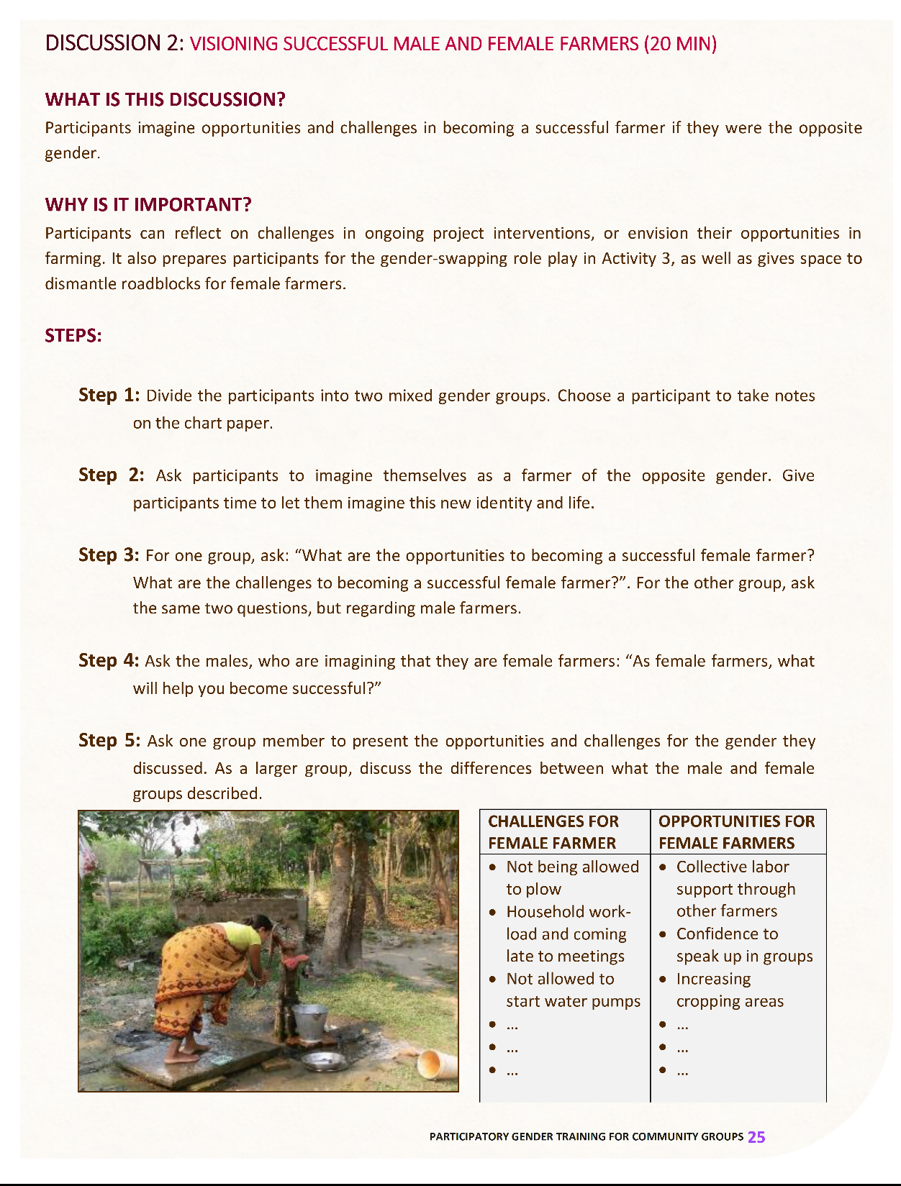
gender &
natural resource management
& projects
How can you encourage/facilitate gender inclusion in projects?
Notes:
We will be sharing this manual with you – Participatory Gender Training for Community Groups. It has many activities in it, including visualizing what the other gender experiences in farming, as well as a role-playing game where men and women switch roles and act out scenarios. This requires very careful facilitation so that nobody offends other people!

Slide 63
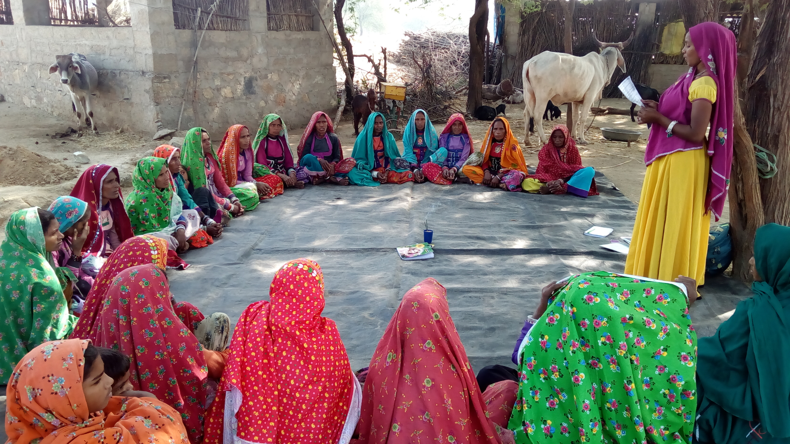
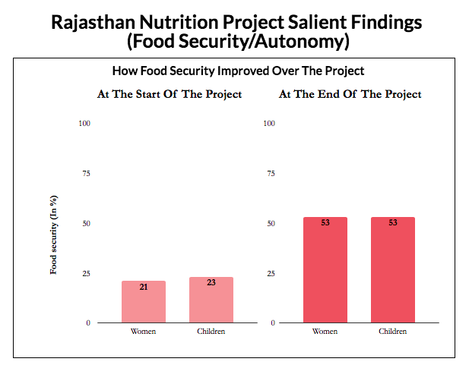
gender &
natural resource management
& projects
Rajasthan Nutrition Project (India)
“It was a habit for us. I never thought of it as discrimination against women, although I remained hungry several times and my health suffered.”
"In our patriarchal society, men are not brought up to care for their wives. So we have to sensitise them to gender issues.“ Geeta Pandey, BBC News
Nutrition training for women + Gender training for men + Having families eat dinner together
freedomfromhunger-india.org
Notes:
I want to share 2 examples of gender-inclusive projects.
1)
The first is not so related to natural resource management. This is from India. In a community where the tradition was that women ate only after everyone else in the family finished their dinner, women were suffering from low energy and malnutrition – because they were not eating enough. A project, Rajasthan Nutrition Project by Freedom from Hunger, had built trust with the community working with women and men on issues of women and children’s nutrition and health. They asked some families to try allowing the women to eat dinner with everyone else.
They found that soon, the whole families would have higher well-being. The women were healthier and happier, and could better contribute to the family and community. Also, the families found that they really enjoyed having time to sit and talk together. The project also provided training in nutrition, cooking, and farming so that women could grow and cook more nutritious food, and provided gender training for men. They empowered women to work for better nutrition, and worked with men to create an enabling environment for women.
I recommend you learn more about this project – I will include links in the information packet that I send to you.

Slide 64
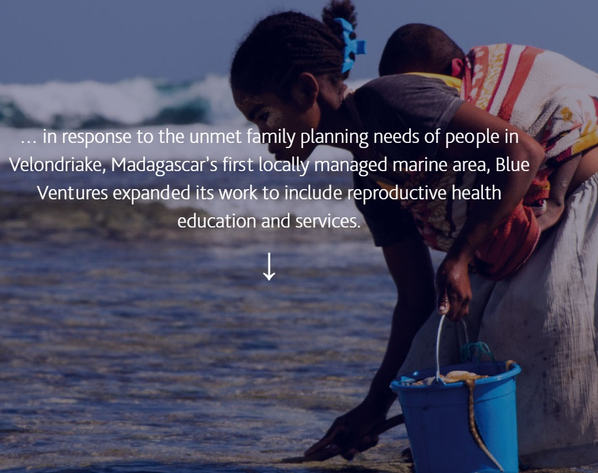
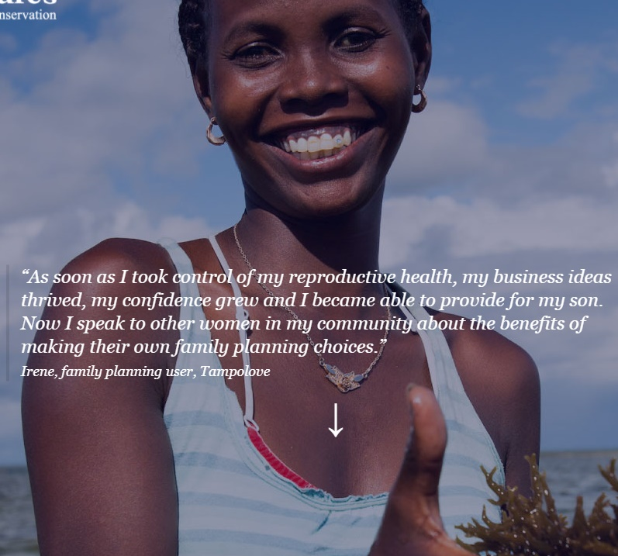
gender &
natural resource management
& projects
Blue Ventures & Family Planning (Madagascar)
Notes:
2)
There is an organization called Blue Ventures that works in Madagascar. They work closely with communities on marine natural resource management. After many interviews and consultations, they learned that women identified family planning as a priority need. For them, it was very difficult to support their families without knowing when they might get pregnant again. Each new child made it more difficult for the parents to support their households, and would contribute to overfishing.
So, working with a health organization, Blue Ventures helped these communities establish family planning programs. They trained women in the community to advise and help other women with family planning, and many other communities wanted to do the same. This has been a very successful program – the women are very happy with this.
This is an example of a very sensitive topic, but also an important topic. Blue Ventures could only do this very carefully, with the community leading the way.
I am not suggesting that you suggest family planning in your work, or that you try to change how families eat dinner! These are just examples of gender-related projects that helped their communities.

Slide 65
gender &
natural resource management
& projects
How can you encourage/facilitate gender inclusion in organizations?
Ideas from group?
Notes:
Finally, I want to go ogver how you can encourage and facilitate gender inclusion in your organizations. We heard some good recommendations yesterday. Can you give me some examples now? [ASK FOR EXAMPLES]
Great!
Generally, it is good to amplify women’s voices. If your female colleague says something and is ignored, help her – repeat her idea and give her credit. Make sure she is heard.
It is also good to have women in leadership positions, as well as men.
I mentioned “gender balance” earlier – this is what I mean. If you have an organization with 10 men and 10 women, it seems gender-balanced. But then if you learn that all of the leadership positions are held by men, and the women are mainly interns and admin staff, is this still gender balanced?
Another important consideration is that women’s concerns need to be taken seriously, and that men play a role in helping address these concerns. Both men and women are responsible for a culture of respect and inclusion.
An example to demonstrate these points comes from a recent project training. One of the female staff brought up her concern that she and her female colleagues felt unsafe traveling to the field alone. While the project coordinator was talking about what to do in the case of rape, one of the men joked, “haha, how about if you are a man and you are raped?” All of the men in the project (except the project coordinator) started to laugh.
What is wrong with this? [ASK FOR IDEAS]
First, it shows the women that the men on the project do not take their safety seriously. This is not a culture of respect. It also might make women less willing to talk about their concerns in the future.
Second, men can be victims of sexual assault. By making this a joke, it makes sexual assault on men seem like it is not a serious issue. So, if any of the men on the project are attacked, they might feel ashamed to report it.
The men in the project should care about these issues, because the women are their colleagues. They can help their female colleagues who have been attacked. They can support them.
Also, I was at this meeting, and I did not say anything to the group. I spoke to the project coordinator about my concerns, but I did not tell anyone else. I wish I had. This was an opportunity to amplify women’s voices – I was in a senior position, and I should have said, “This is a very serious issue. Everyone in this room should care about it. I am glad that my female colleague was brave enough to bring this difficult issue up in front of everyone.”
So, this example demonstrates many points about making a project more gender-inclusive.
Tomorrow, we will talk more about how you can evaluate how gender-inclusive your project and organization are. It will only be a half day, so we will finish at 12.

Slide 66







gender &
natural resource management
& projects
How can you encourage/facilitate gender inclusion in organizations?
Ideas from group?
Amplify women’s voices
Have women in leadership positions - “gender balance” - #s versus position types
Gender equality in your organization’s code of conduct/operating guidelines
Gender focal person/HR that responds to gender concerns
Gender awareness trainings
Ensure that women’s concerns (e.g., safety in the field) are taken seriously, and that men play a role in helping address these concerns
Men and women are responsible for culture of respect, inclusion, and open communication
Example: Joke about female staff safety at another project workshop
Notes:
Finally, I want to go ogver how you can encourage and facilitate gender inclusion in your organizations. We heard some good recommendations yesterday. Can you give me some examples now? [ASK FOR EXAMPLES]
Great!
Generally, it is good to amplify women’s voices. If your female colleague says something and is ignored, help her – repeat her idea and give her credit. Make sure she is heard.
It is also good to have women in leadership positions, as well as men.
I mentioned “gender balance” earlier – this is what I mean. If you have an organization with 10 men and 10 women, it seems gender-balanced. But then if you learn that all of the leadership positions are held by men, and the women are mainly interns and admin staff, is this still gender balanced?
Another important consideration is that women’s concerns need to be taken seriously, and that men play a role in helping address these concerns. Both men and women are responsible for a culture of respect and inclusion.
An example to demonstrate these points comes from a recent project training. One of the female staff brought up her concern that she and her female colleagues felt unsafe traveling to the field alone. While the project coordinator was talking about what to do in the case of rape, one of the men joked, “haha, how about if you are a man and you are raped?” All of the men in the project (except the project coordinator) started to laugh.
What is wrong with this? [ASK FOR IDEAS]
First, it shows the women that the men on the project do not take their safety seriously. This is not a culture of respect. It also might make women less willing to talk about their concerns in the future.
Second, men can be victims of sexual assault. By making this a joke, it makes sexual assault on men seem like it is not a serious issue. So, if any of the men on the project are attacked, they might feel ashamed to report it.
The men in the project should care about these issues, because the women are their colleagues. They can help their female colleagues who have been attacked. They can support them.
Also, I was at this meeting, and I did not say anything to the group. I spoke to the project coordinator about my concerns, but I did not tell anyone else. I wish I had. This was an opportunity to amplify women’s voices – I was in a senior position, and I should have said, “This is a very serious issue. Everyone in this room should care about it. I am glad that my female colleague was brave enough to bring this difficult issue up in front of everyone.”
So, this example demonstrates many points about making a project more gender-inclusive.
Tomorrow, we will talk more about how you can evaluate how gender-inclusive your project and organization are. It will only be a half day, so we will finish at 12.

Slide 67
gender &
natural resource management
& projects
How can you evaluate if you organization, project, community are using gender-inclusive practices?
Ideas from group?
Notes:
It is important to evaluate how successful your project is in including gender issues. How might you do this?

Slide 68
gender &
natural resource management
& projects
How can you evaluate if you organization, project, community are using gender-inclusive practices?
1. Indicators
“Indicators” are things you can measure to demonstrate what your project is accomplishing
They have to be MEASURABLE
Notes:
We will briefly go over ways to evaluate your project’s effectiveness. This is a big topic! We do not want to make this confusing – we want to present you with an overview of ways to evaluate your work. This is just to help you understand what types of evaluation approaches exist and to give basic information about them. IUCN Netherlands will work with you to develop an evaluation approach.
First, you can measure your performance by indicators. Indicators are ways to demonstrate that your project is accomplishing specific goals. You need to be able to measure these indicators.

Slide 69
gender &
natural resource management
& projects
OBJECTIVE/GOAL | INDICATOR | HOW TO MEASURE
More women’s participation in project activities | By the end of 2018, project meetings will have at least 45% female participants | Attendance records
1. Indicators
Notes:
For example, if your goal is to have “more women’s participation in project activities,” one indicator could be: “By the end of 2018, project meetings will have at least 45% female participants.” You can measure this by looking at attendance records. Other examples might include the number of women who have improved incomes – you can measure this from interviews or surveys on income levels.
Another example is the number of women who are in decision-making positions – you can measure this from a committee membership list, for example.

Slide 70
gender &
natural resource management
& projects
OBJECTIVE/GOAL | INDICATOR | HOW TO MEASURE
More women’s participation in project activities | By the end of 2018, project meetings will have at least 45% female participants | Attendance records
Women feel more empowered to participate in activities | 15% more women feel confident that their ideas are listened to | Interview survey (before and after)
1. Indicators
Requires “sex disaggregated data” – i.e., data for men and data for women
Aggregated data: 50 participants | Sex disaggregated: 38 men, 12 women participants
→ Collect information on gender, age, other important characteristics (ethnic group, religion, etc.)
Notes:
You can also have indicators about perceptions. For example, if your goal is that “women feel more empowered to participate in activities” your indicator might be something like “15% more women feel confident that their ideas are listened to, compared to when the project first started.” You can measure this from interview surveys.
Assessing gender with indicators requires “sex or gender disaggregated data.” So, you need information on women and on men.
For example, if you only collect information on # of participants in your meetings, you can say “we had 50 participants at the last meeting.” But this does not tell us anything about gender!
So, if you collect information on participant gender, you can say, “We had 38 men and 12 women participante in our last meeting.” This is more useful for gender assessments!
So, when collecting information on participants, be sure to collect information on gender and other important characteristics, such as age, occupation, or – if relevant – ethnic group and religion.

Slide 71
gender &
natural resource management
& projects
How can you evaluate if you organization, project, community are using gender-inclusive practices?
Advantage: gives you a more complete picture of the situation
Indicators measure things that you expect to happen
More open evaluation – allows you to measure unexpected outcomes/impacts
2. More open evaluation
Notes:
There are also more open approaches for evaluation. With indicators, you develop indicators and measure them – but this means you only observe some of your project’s impacts. You will only measure the impacts that you expect to happen. You will not be able to measure unexpected impacts very well, because you probably did think to develop indicators for these impacts – because they are unexpected!
Also, with indicators, you might not collect information that explains why you project had an impact.
With other approaches to evaluation, you can collect more information on unexpected outcomes and you can better understand the reasons why your project had certain impacts.

Slide 72
gender &
natural resource management
& projects
How can you evaluate if you organization, project, community are using gender-inclusive practices?
Outcome Harvesting approach
Document changes in your project communities
Evaluate how these changes could be linked to your project’s work, using your theory of change
Evaluate & verify with project stakeholders
IUCN NL uses this
2. More open evaluation
Identify change
Is it significant?
How did your work contribute?
Notes:
Outcome Harvesting is one of these approaches. You document changes that have happened in your project communities over time. Then, you work backward to assess how these changes could be linked to your project’s work.

Slide 73
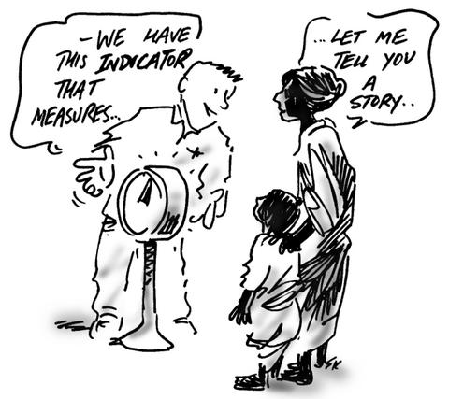
gender &
natural resource management
& projects
How can you evaluate if you organization, project, community are using gender-inclusive practices?
Most Significant Changes approach
Learn about the impacts of your project from listening to people’s stories about their experiences
2. More open evaluation
Notes:
Another approach is the Most Significant changes approach. You learn about the impacts of your project from listening to people’s stories about their experiences. Yin Yin has recently used this to evaluate impact of a Point B program – she will explain more about it to you.

Slide 74
gender &
natural resource management
& projects
How can you evaluate if you organization, project, community are using gender-inclusive practices?
1. Indicators
Often, the 2 are used together!
2. More open evaluation
Notes:
The strongest evaluation will use these 2 types of approaches together. The indicators can give an easily measured idea of how the project is succeeding at meeting its goals; the more open evaluations are better for providing explanations for the impacts of the project, and for understanding unexpected impacts. Using both together, you can get a more complete idea of how your project is doing.

Slide 75
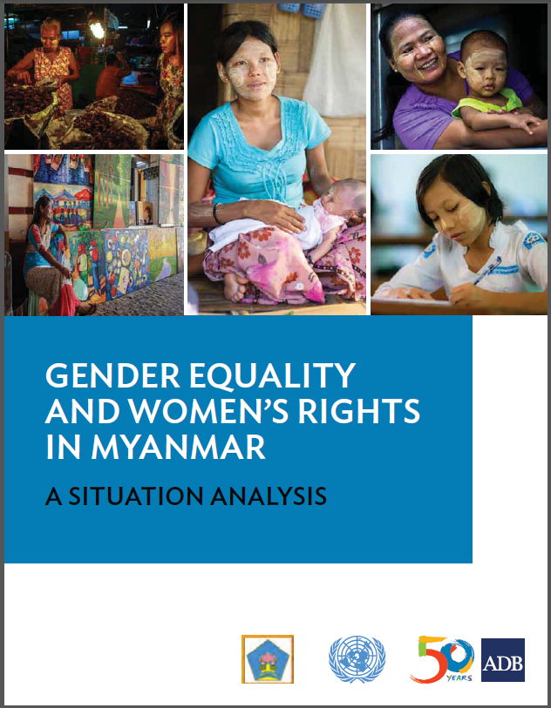
gender
& policy/development in Myanmar
Myanmar Constitution:
guarantees all persons equal rights before the law and equal legal protection (Section 347)
does not discriminate against any Myanmar citizen on the basis of sex (Section 348).
→ but many people have the idea that don’t need a legal definition of “discrimination against women” in national legislation...but...
Notes:
I am not so familiar with Myanmar’s legal framework for gender. I found this report to be very useful – “Gender Equality and Women’s Rights in Myanmar – a situation analysis.” We will distribute this to you by email later.
The Myanmar constitution guarantees all persons equal rights and equal legal protection, and does not discriminate against any Myanmar citizen on the basis of sex.
However, many believe that women do not need additional legal rights and protection in Myanmar, and that there is no need for a legal definition of “discrimination against women” in national legislation.

Slide 76
gender
& policy/development in Myanmar
Constitution; Article 352:
“The Union shall, upon specified qualifications being fulfilled, in appointing or assigning duties to civil service personnel, not discriminate for or against any citizen of the Republic of the Union of Myanmar, based on race, birth, religion, and sex.
“However, nothing in this Section shall prevent appointment of men to the positions that are suitable for men only.”
Notes:
However, an international committee on gender equality has concerns about gender equality in Myanmar’s legal framework.
For example, even though the constitution says: [Read 1st paragraph],
It also says: [Read 2nd paragraph]

Slide 77
gender
& policy/development in Myanmar
Myanmar rankings in Gender Equality:
2014 Gender Inequality Index: 85th of 187 countries
2012 Social Institutions and Gender Index:
44th of 86 countries
8th of 9 countries in East Asia and the Pacific
To note:
National Strategic Plan for Advancement of Women
Myanmar National Committee for Women’s Affairs
Myanmar Women’s Affairs Federation
Notes:
Looking at some international rankings of Myanmar, in terms of gender equality, it appears that, while Myanmar is not the worst country for gender equality, it has not made as much progress as many other countries. This demonstrates a need for improved gender equality in many sectors.
To help achieve this, there is the National Strategic Plan for the Advancement of Women. This outlines a plan for improving gender equality.
To implement this, the Myanmar National Committee for Women’s Affairs was formed – it is a collaboration across ministries.
The NGO Myanmar Women’s Affairs Federation links the National Committee to various local and international NGOs.

Slide 78
gender
& policy/development in Myanmar
Key Recommendations:
Review and revise laws from a gender perspective to ensure gender equality
Use gender research to inform policy and programs
Ensure that laws related to social protection include women’s concerns
Promote women’s participation in formation, implementation, and monitoring of policies, plans, and programs
Notes:
Key recommendations in this report include: [read list]
So, in mainstreaming gender in your projects and communities, you are in alignment with these recommendations, as well as with national and international plans and agreements to promote gender equality.

Slide 79
gender
useful resources
We will distribute an e-folder of resources
Many resources online
For research tools: University social science depts.
NGOs, CSOs, projects with a gender focus
Notes:
We are almost finished! As I have mentioned, we will distribute resources that you can refer to.
There are also many resources online, and I encourage you to search for them.
If you need help developing research tools, your local university might have expertise – especially the social science departments (anthropology, geography)
You can also contact organizations and projects who work on gender as their main focus. For example, we met with the Mon Women Organization when we were developing this training to learn from their experiences.

Slide 80
gender &
natural resource management
& you!
HOW STRONGLY DO YOU AGREE? (1 = strongly disagree, 5 = strongly agree)
GENDER IS IMPORTANT IN NATURAL RESOURCE MANAGEMENT
WOMEN CAN PLAY AN IMPORTANT ROLE IN NATURAL RESOURCE MANAGEMENT
GENDER ISSUES ARE ONLY A CONCERN FOR WOMEN
MEN SHOULD PLAY AN ACTIVE ROLE IN GENDER INCLUSION
WOMEN HAVE ENOUGH RIGHTS & INCLUSION IN NATURAL RESOURCE MANAGEMENT
What have you learned from this training?
Notes:
I would like to ask you to fill out the same survey you filled out at the beginning of this workshop.
Now, can some of you share with us the most interesting or important thing you learned from this training?

Slide 81
gender &
natural resource management
& you!
PERSONAL PLEDGES/COMMITMENTS
How will you promote gender inclusion in your organization, project, and natural resource management?
Notes:
For our final activity, we will make our own pledges or commitments to how we can promote gender inclusion – either in our organization, project, or natural resource management. Come up with 1 idea (although you can also come up with more ideas for your own personal development!).
[5 minutes to write down]
Could we have some volunteers share their pledges?

Slide 82
gender & natural resource management
THANK YOU!
Organizing: Southern Youth
Support: IUCN Netherlands
Funding: IUCN NL + IUCN ARO
Mon Women Organization
...and you!
contact: tara.whitty@gmail.com

